Slide 1
Memory Hierarchy
Microprocessor Design and Application
마이크로 프로세서 설계 및 응용
2017 Spring
Minseong Kim (김민성)
Chapter 5 (2/3)

Slide 2
Major topics
Chapter 1: Computer Abstractions and Technology
Chapter 2: Instructions: Language of the Computer
Chapter 3: Arithmetic for Computers
Chapter 4: The Processor
Chapter 5: Exploiting Memory Hierarchy
Chapter 6: Parallel Processors from Client to Cloud

Slide 3
Dependability
Fault: failure of a component
May or may not lead to system failure
Service accomplishment
Service delivered as specified
Restoration
Failure
Service interruption
Deviation from specified service

Slide 4
Dependability Measures
Reliability: mean time to failure (MTTF)
Service interruption: mean time to repair (MTTR)
Mean time between failures
MTBF = MTTF + MTTR
Availability = MTTF / (MTTF + MTTR)
Improving Availability
Increase MTTF: fault avoidance, fault tolerance, fault forecasting
Reduce MTTR: improved tools and processes for diagnosis and repair

Slide 5
The Hamming SEC Code
Hamming distance
Number of bits that are different between two bit patterns
Minimum distance = 2 provides single bit error detection
E.g. parity code
Minimum distance = 3 provides single error correction, 2 bit error detection

Slide 6
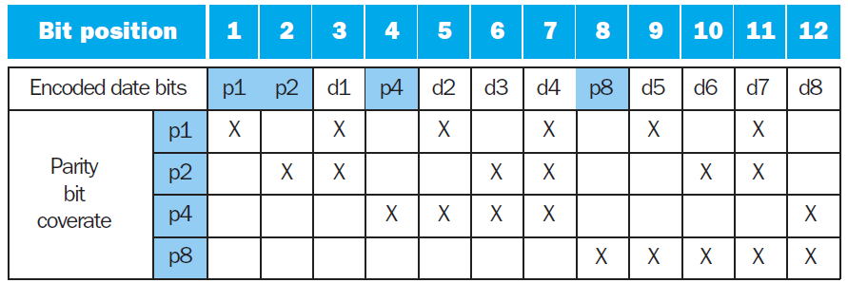
Encoding SEC
To calculate Hamming code:
Number bits from 1 on the left
All bit positions that are a power 2 are parity bits
Each parity bit checks certain data bits:

Slide 7
Decoding SEC
Value of parity bits indicates which bits are in error
Use numbering from encoding procedure
E.g.
Parity bits = 0000 indicates no error
Parity bits = 1010 indicates bit 10 was flipped

Slide 8
SEC/DEC Code
Add an additional parity bit for the whole word (p_{n})
Make Hamming distance = 4
Decoding:
Let H = SEC parity bits
H even, p_{n} even, no error
H odd, p_{n} odd, correctable single bit error
H even, p_{n} odd, error in p_{n} bit
H odd, p_{n} even, double error occurred
Note: ECC DRAM uses SEC/DEC with 8 bits protecting each 64 bits

Slide 9
Virtual Machines
Host computer emulates guest operating system and machine resources
Improved isolation of multiple guests
Avoids security and reliability problems
Aids sharing of resources
Virtualization has some performance impact
Feasible with modern high-performance comptuers
Examples
IBM VM/370 (1970s technology!)
VMWare
Microsoft Virtual PC

Slide 10
Virtual Machine Monitor
Maps virtual resources to physical resources
Memory, I/O devices, CPUs
Guest code runs on native machine in user mode
Traps to VMM on privileged instructions and access to protected resources
Guest OS may be different from host OS
VMM handles real I/O devices
Emulates generic virtual I/O devices for guest

Slide 11
Example: Timer Virtualization
In native machine, on timer interrupt
OS suspends current process, handles interrupt, selects and resumes next process
With Virtual Machine Monitor
VMM suspends current VM, handles interrupt, selects and resumes next VM
If a VM requires timer interrupts
VMM emulates a virtual timer
Emulates interrupt for VM when physical timer interrupt occurs

Slide 12
Instruction Set Support
User and System modes
Privileged instructions only available in system mode
Trap to system if executed in user mode
All physical resources only accessible using privileged instructions
Including page tables, interrupt controls, I/O registers
Renaissance of virtualization support
Current ISAs (e.g., x86) adapting

Slide 13
Virtual Memory
Use main memory as a “cache” for secondary (disk) storage
Managed jointly by CPU hardware and the operating system (OS)
Programs share main memory
Each gets a private virtual address space holding its frequently used code and data
Protected from other programs
CPU and OS translate virtual addresses to physical addresses
VM “block” is called a page
VM translation “miss” is called a page fault

Slide 14
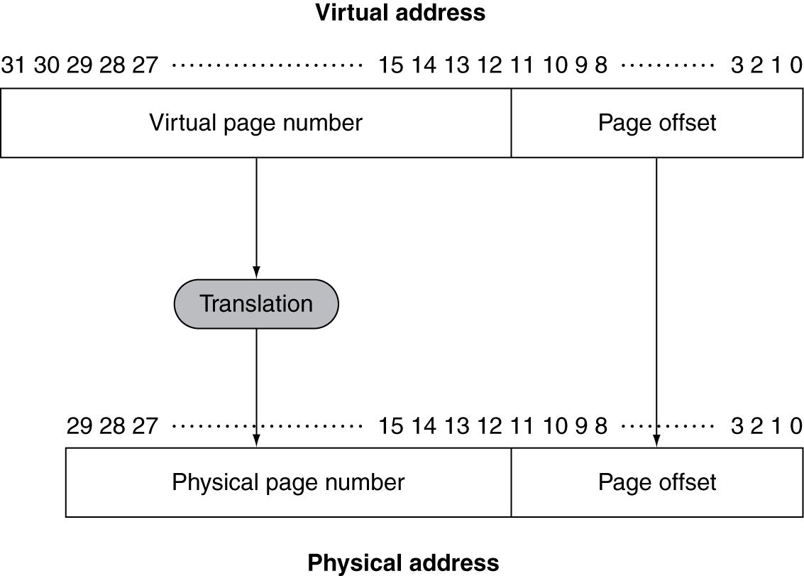
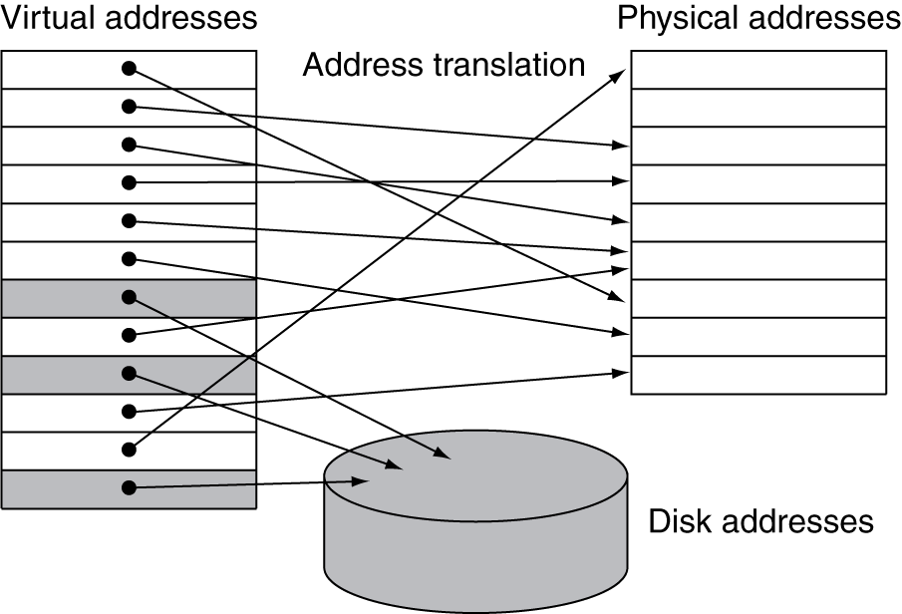
Address Translation
Fixed-size pages (e.g., 4K)

Slide 15
Page Fault Penalty
On page fault, the page must be fetched from disk
Takes millions of clock cycles
Handled by OS code
Try to minimize page fault rate
Fully associative placement
Smart replacement algorithms

Slide 16
Page Tables
Stores placement information
Array of page table entries, indexed by virtual page number
Page table register in CPU points to page table in physical memory
If page is present in memory
PTE stores the physical page number
Plus other status bits (referenced, dirty, …)
If page is not present
PTE can refer to location in swap space on disk

Slide 17
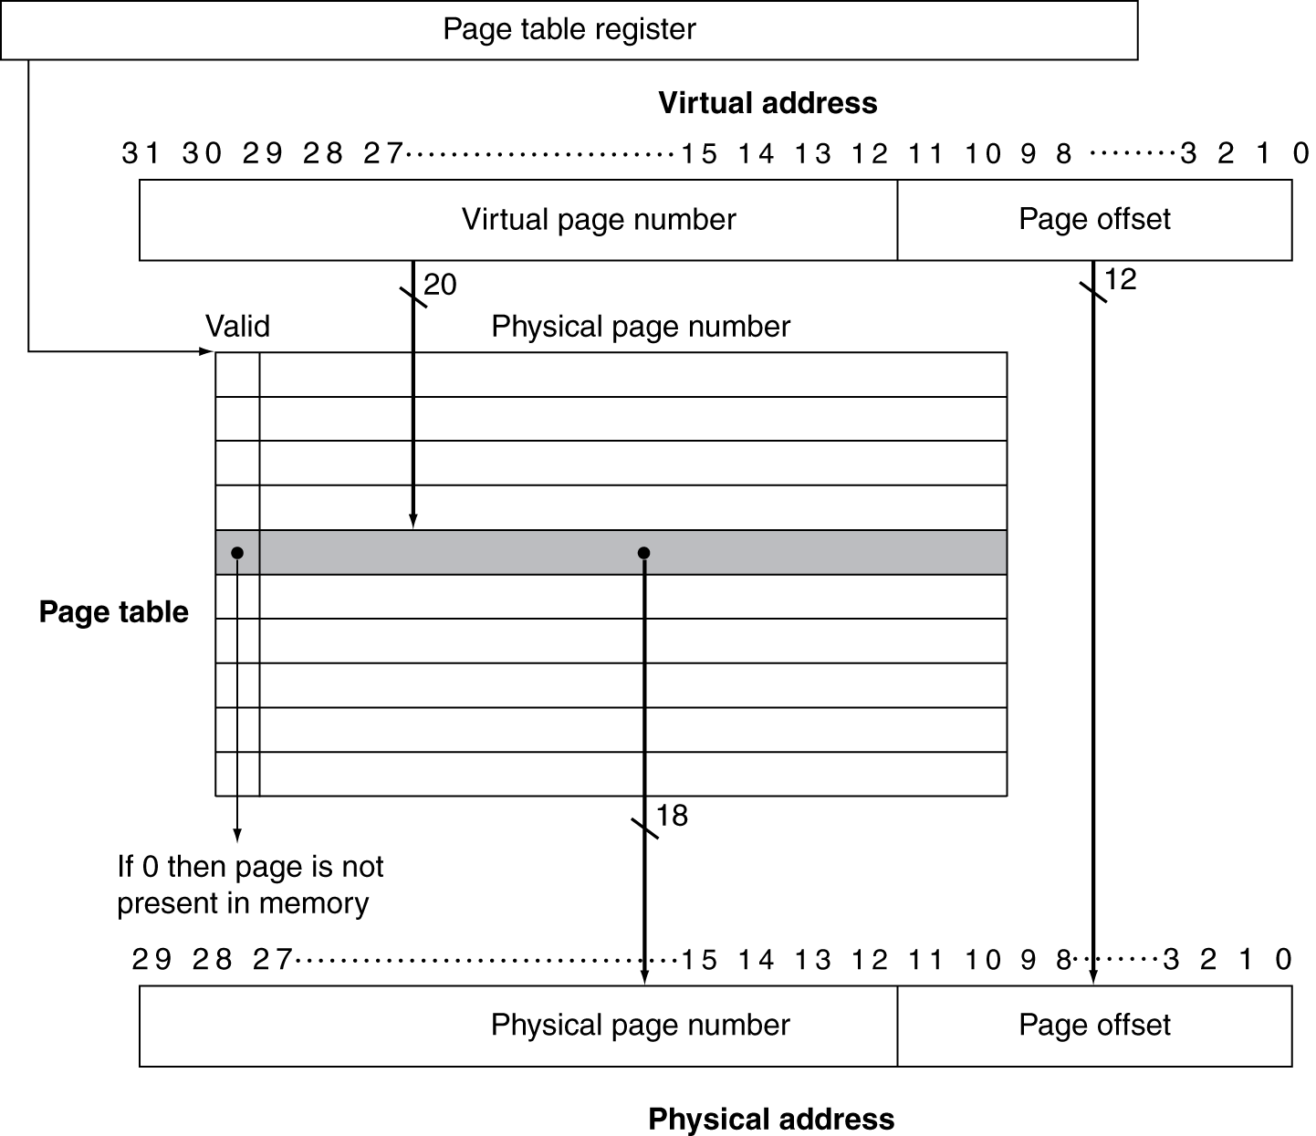
Translation Using a Page Table

Slide 18
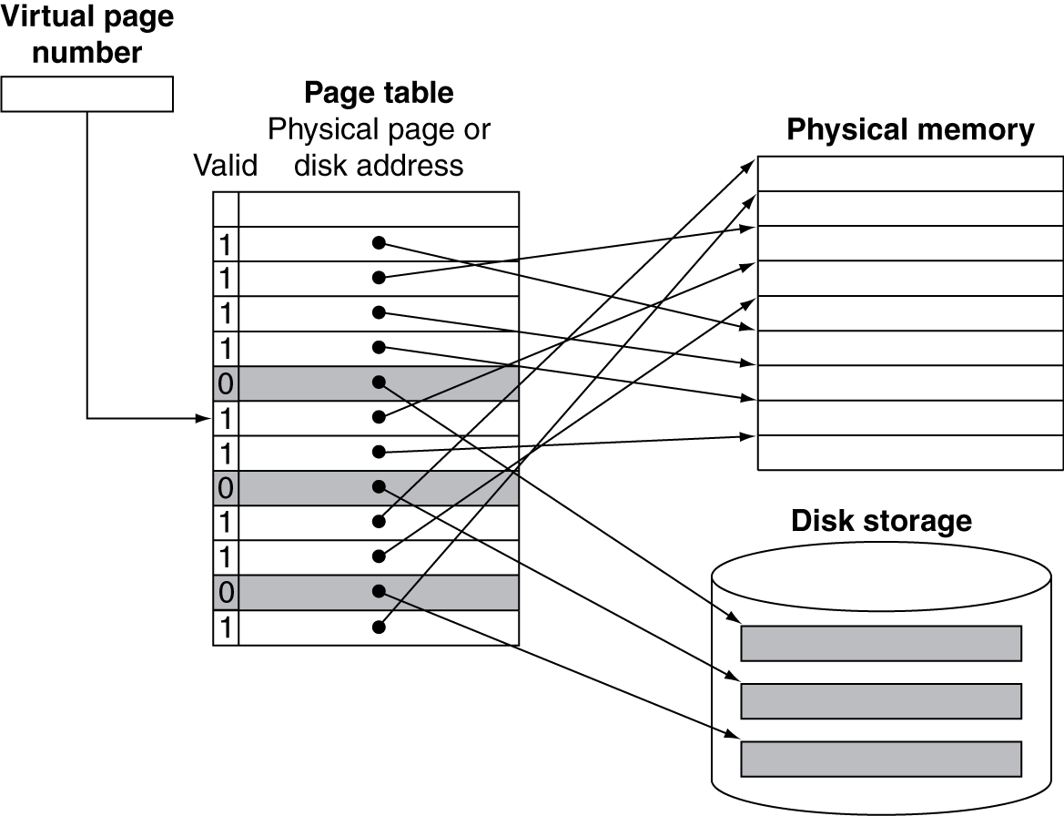
Mapping Pages to Storage

Slide 19
Replacement and Writes
To reduce page fault rate, prefer least-recently used (LRU) replacement
Reference bit (aka use bit) in PTE set to 1 on access to page
Periodically cleared to 0 by OS
A page with reference bit = 0 has not been used recently
Disk writes take millions of cycles
Block at once, not individual locations
Write through is impractical
Use write-back
Dirty bit in PTE set when page is written

Slide 20
Fast Translation Using a TLB
Address translation would appear to require extra memory references
One to access the PTE
Then the actual memory access
But access to page tables has good locality
So use a fast cache of PTEs within the CPU
Called a Translation Look-aside Buffer (TLB)
Typical: 16–512 PTEs, 0.5–1 cycle for hit, 10–100 cycles for miss, 0.01%–1% miss rate
Misses could be handled by hardware or software

Slide 21
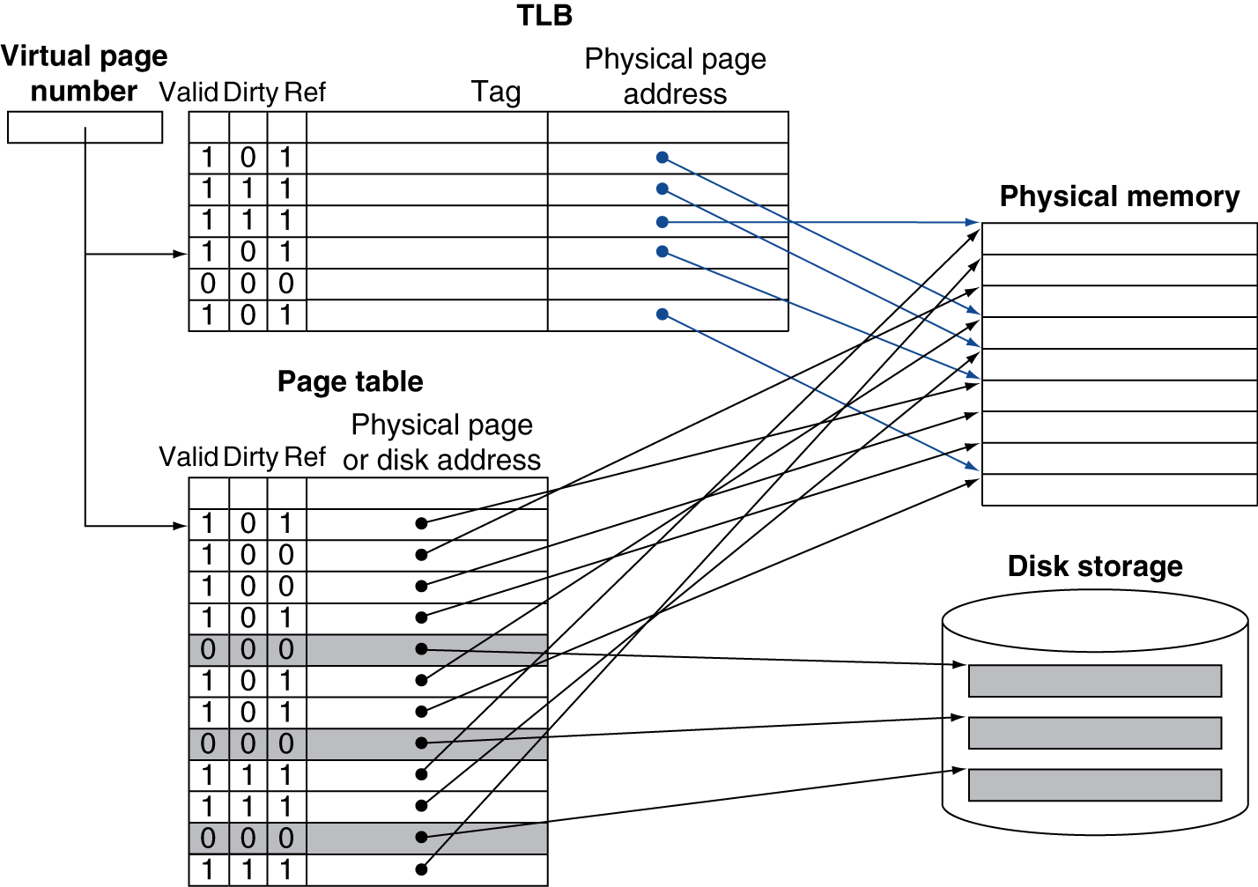
Fast Translation Using a TLB

Slide 22
TLB Misses
If page is in memory
Load the PTE from memory and retry
Could be handled in hardware
Can get complex for more complicated page table structures
Or in software
Raise a special exception, with optimized handler
If page is not in memory (page fault)
OS handles fetching the page and updating the page table
Then restart the faulting instruction

Slide 23
TLB Miss Handler
TLB miss indicates
Page present, but PTE not in TLB
Page not preset
Must recognize TLB miss before destination register overwritten
Raise exception
Handler copies PTE from memory to TLB
Then restarts instruction
If page not present, page fault will occur

Slide 24
Page Fault Handler
Use faulting virtual address to find PTE
Locate page on disk
Choose page to replace
If dirty, write to disk first
Read page into memory and update page table
Make process runnable again
Restart from faulting instruction

Slide 25
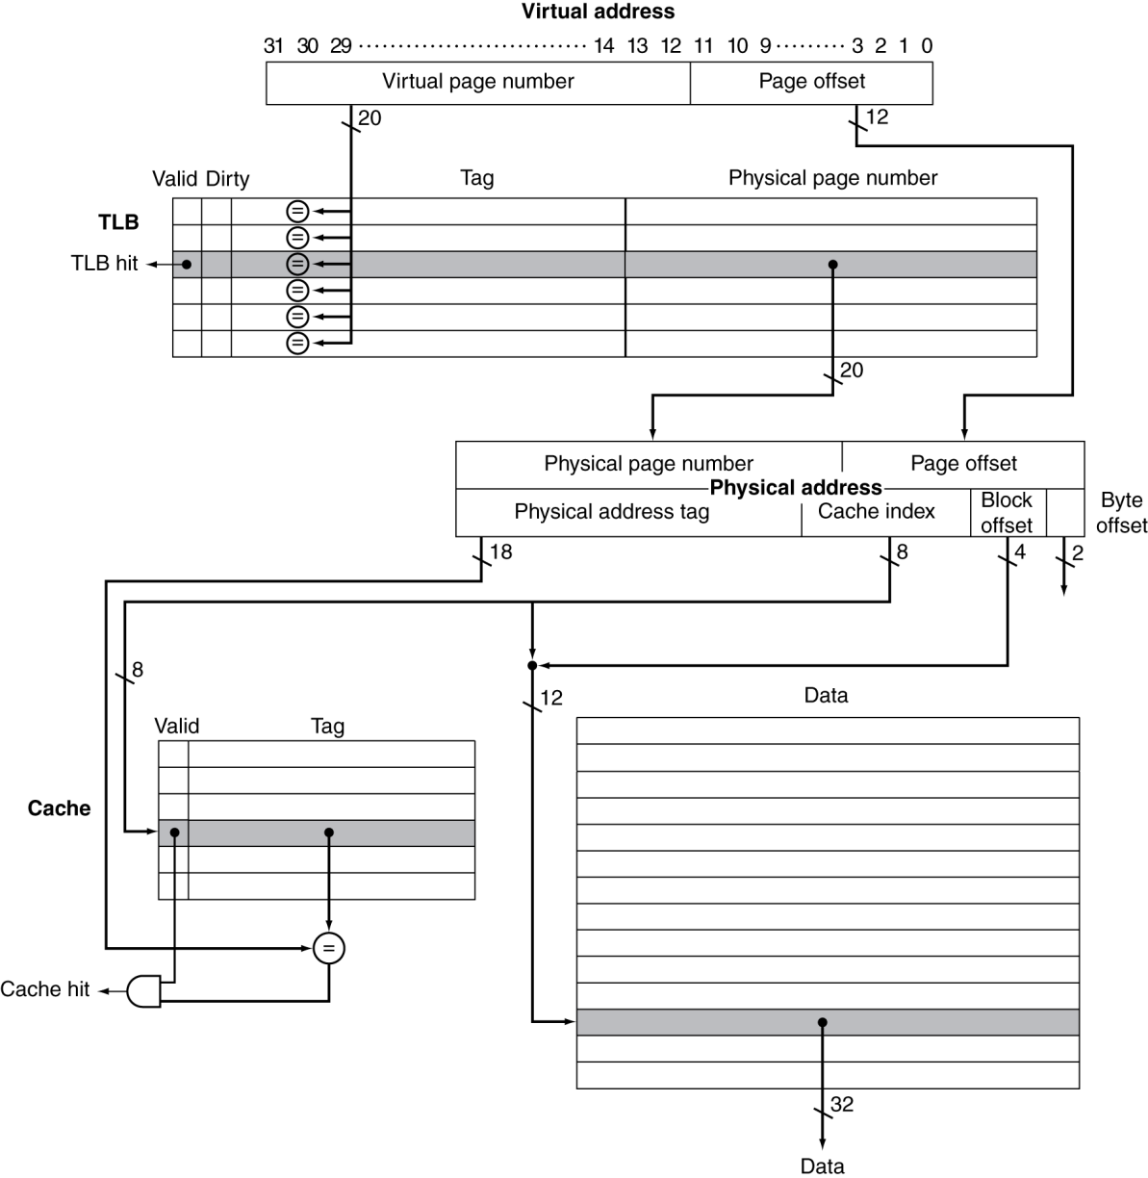
TLB and Cache Interaction
If cache tag uses physical address
Need to translate before cache lookup
Alternative: use virtual address tag
Complications due to aliasing
Different virtual addresses for shared physical address

Slide 26
Memory Protection
Different tasks can share parts of their virtual address spaces
But need to protect against errant access
Requires OS assistance
Hardware support for OS protection
Privileged supervisor mode (aka kernel mode)
Privileged instructions
Page tables and other state information only accessible in supervisor mode
System call exception (e.g., syscall in MIPS)

Slide 27
The Memory Hierarchy
Common principles apply at all levels of the memory hierarchy
Based on notions of caching
At each level in the hierarchy
Block placement
Finding a block
Replacement on a miss
Write policy

Slide 28
Block Placement
Determined by associativity
Direct mapped (1-way associative)
One choice for placement
n-way set associative
n choices within a set
Fully associative
Any location
Higher associativity reduces miss rate
Increases complexity, cost, and access time

Slide 29
Finding a Block
Hardware caches
Reduce comparisons to reduce cost
Virtual memory
Full table lookup makes full associativity feasible
Benefit in reduced miss rate
Associativity | Location method | Tag comparisons
Direct mapped | Index | 1
n-way set associative | Set index, then search entries within the set | n
Fully associative | Search all entries | #entries
 | Full lookup table | 0

Slide 30
Replacement
Choice of entry to replace on a miss
Least recently used (LRU)
Complex and costly hardware for high associativity
Random
Close to LRU, easier to implement
Virtual memory
LRU approximation with hardware support

Slide 31
Write Policy
Write-through
Update both upper and lower levels
Simplifies replacement, but may require write buffer
Write-back
Update upper level only
Update lower level when block is replaced
Need to keep more state
Virtual memory
Only write-back is feasible, given disk write latency

Slide 32
Sources of Misses
Compulsory misses (aka cold start misses)
First access to a block
Capacity misses
Due to finite cache size
A replaced block is later accessed again
Conflict misses (aka collision misses)
In a non-fully associative cache
Due to competition for entries in a set
Would not occur in a fully associative cache of the same total size

Slide 33
Cache Design Trade-offs
Design change | Effect on miss rate | Negative performance effect
Increase cache size | Decrease capacity misses | May increase access time
Increase associativity | Decrease conflict misses | May increase access time
Increase block size | Decrease compulsory misses | Increases miss penalty. For very large block size, may increase miss rate due to pollution.

Slide 34
Cache Control
Example cache characteristics
Direct-mapped, write-back, write allocate
Block size: 4 words (16 bytes)
Cache size: 16 KB (1024 blocks)
32-bit byte addresses
Valid bit and dirty bit per block
Blocking cache
CPU waits until access is complete
31
10
9
4
3
0
Tag
Index
Offset
18 bits
10 bits
4 bits

Slide 35
Interface Signals
CPU
Cache
Memory
Read/Write
Read/Write
Valid
Valid
Address
32
Address
32
Write Data
32
Write Data
128
Read Data
32
Read Data
128
Ready
Ready
Multiple cycles per access

Slide 36
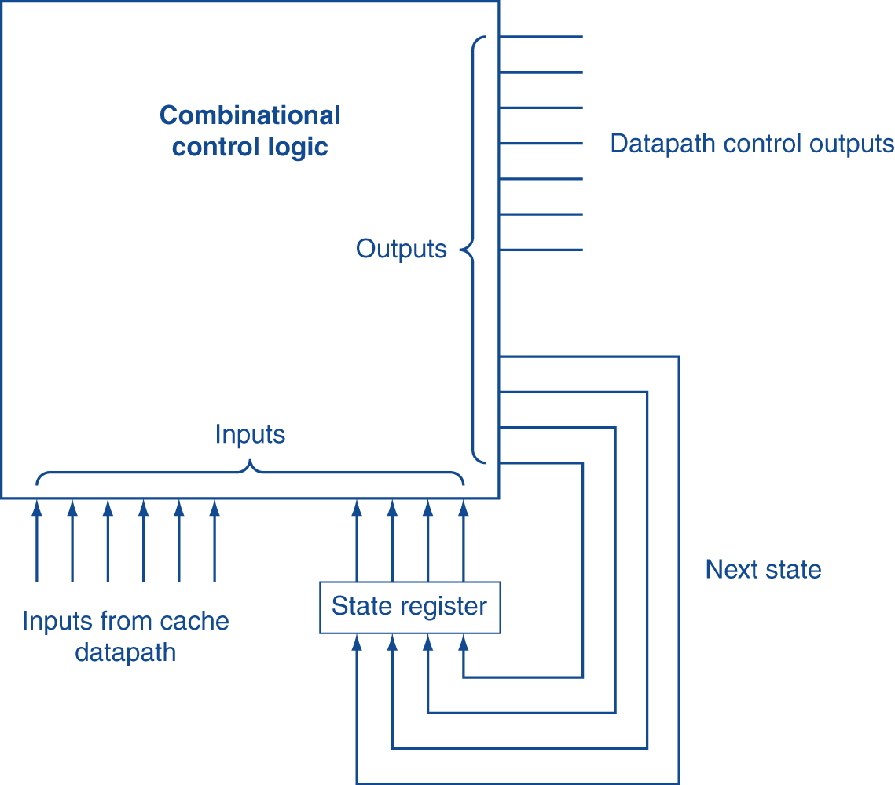
Finite State Machines
Use an FSM to sequence control steps
Set of states, transition on each clock edge
State values are binary encoded
Current state stored in a register
Next state = f_{n} (current state, current inputs)
Control output signals = f_{o} (current state)

Slide 37
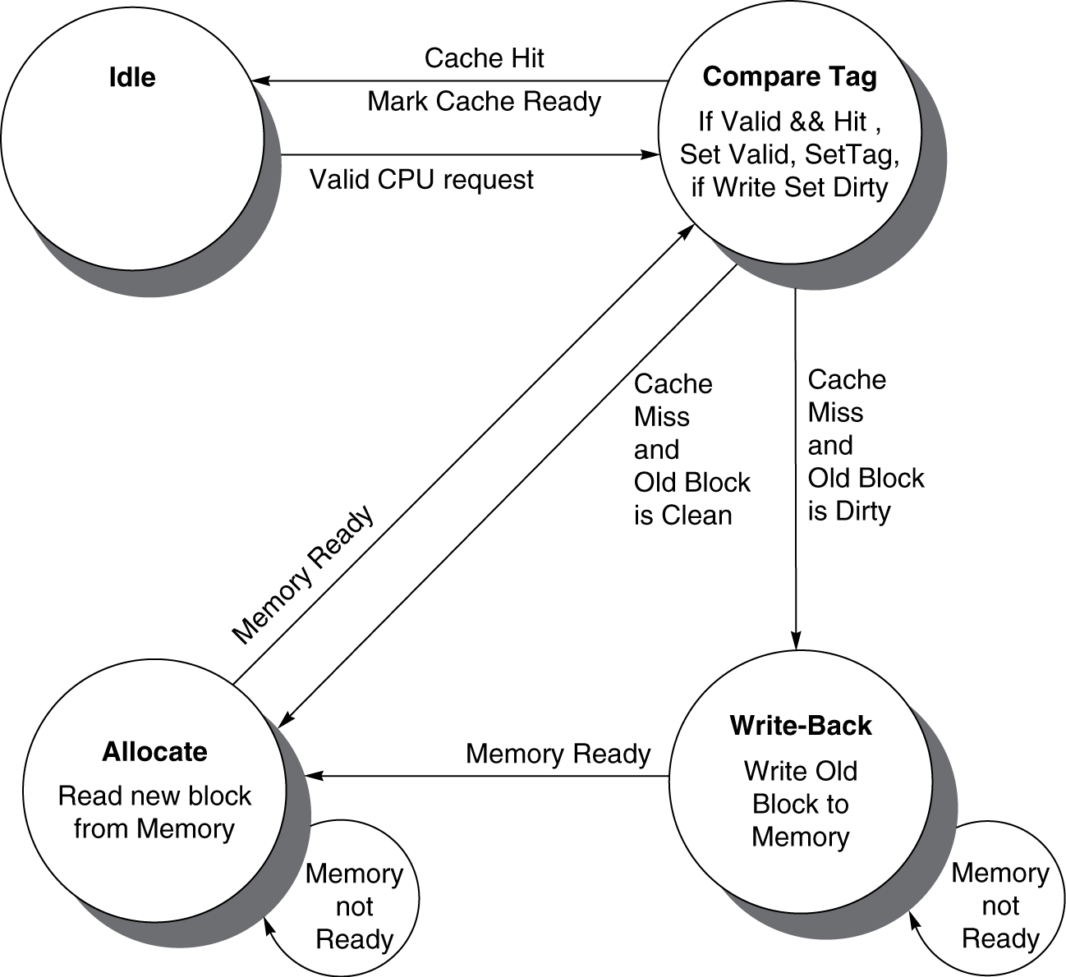
Cache Controller FSM
Could partition into separate states to reduce clock cycle time

Slide 38
Cache Coherence Problem
Suppose two CPU cores share a physical address space
Write-through caches
Time step | Event | CPU A’s cache | CPU B’s cache | Memory
0 |  |  |  | 0
1 | CPU A reads X | 0 |  | 0
2 | CPU B reads X | 0 | 0 | 0
3 | CPU A writes 1 to X | 1 | 0 | 1

Slide 39
Coherence Defined
Informally: Reads return most recently written value
Formally:
P writes X; P reads X (no intervening writes) ⇒ read returns written value
P₁ writes X; P₂ reads X (sufficiently later) ⇒ read returns written value
c.f. CPU B reading X after step 3 in example
P₁ writes X, P₂ writes X ⇒ all processors see writes in the same order
End up with the same final value for X

Slide 40
Cache Coherence Protocols
Operations performed by caches in multiprocessors to ensure coherence
Migration of data to local caches
Reduces bandwidth for shared memory
Replication of read-shared data
Reduces contention for access
Snooping protocols
Each cache monitors bus reads/writes
Directory-based protocols
Caches and memory record sharing status of blocks in a directory

Slide 41
Invalidating Snooping Protocols
Cache gets exclusive access to a block when it is to be written
Broadcasts an invalidate message on the bus
Subsequent read in another cache misses
Owning cache supplies updated value
CPU activity | Bus activity | CPU A’s cache | CPU B’s cache | Memory
 |  |  |  | 0
CPU A reads X | Cache miss for X | 0 |  | 0
CPU B reads X | Cache miss for X | 0 | 0 | 0
CPU A writes 1 to X | Invalidate for X | 1 |  | 0
CPU B read X | Cache miss for X | 1 | 1 | 1

Slide 42
Memory Consistency
When are writes seen by other processors
“Seen” means a read returns the written value
Can’t be instantaneously
Assumptions
A write completes only when all processors have seen it
A processor does not reorder writes with other accesses
Consequence
P writes X then writes Y ⇒ all processors that see new Y also see new X
Processors can reorder reads, but not writes

Slide 43
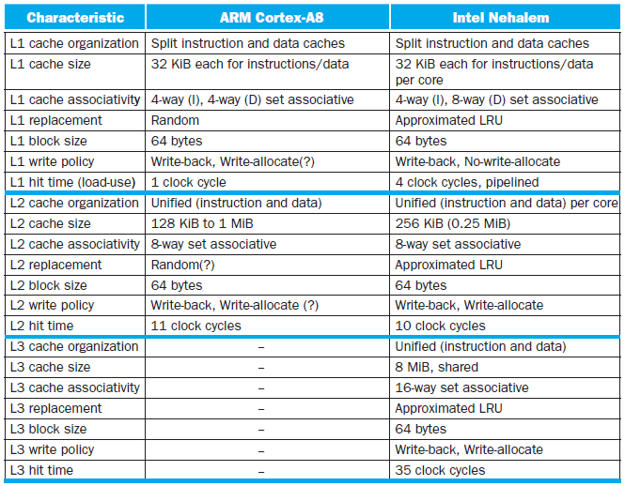
Multilevel On-Chip Caches

Slide 44
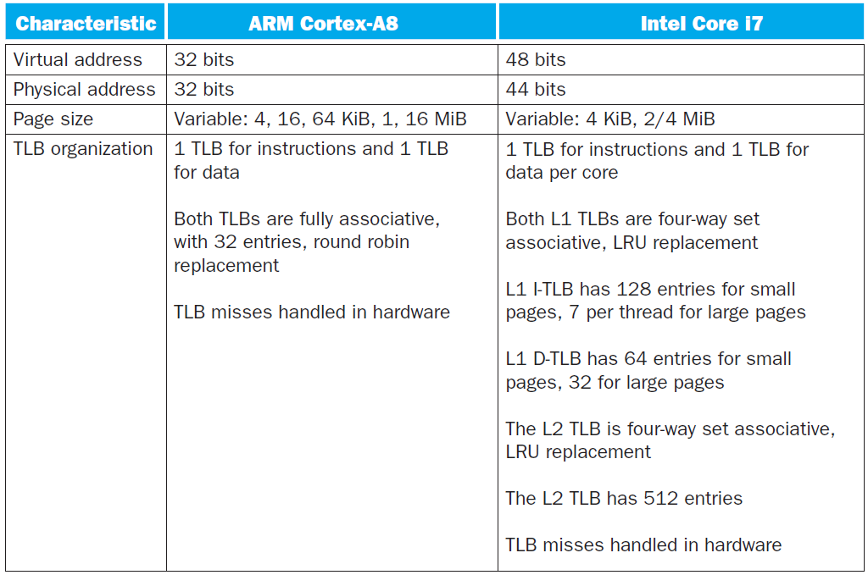
2-Level TLB Organization

Slide 45
Supporting Multiple Issue
Both have multi-banked caches that allow multiple accesses per cycle assuming no bank conflicts
Core i7 cache optimizations
Return requested word first
Non-blocking cache
Hit under miss
Miss under miss
Data prefetching

Slide 46
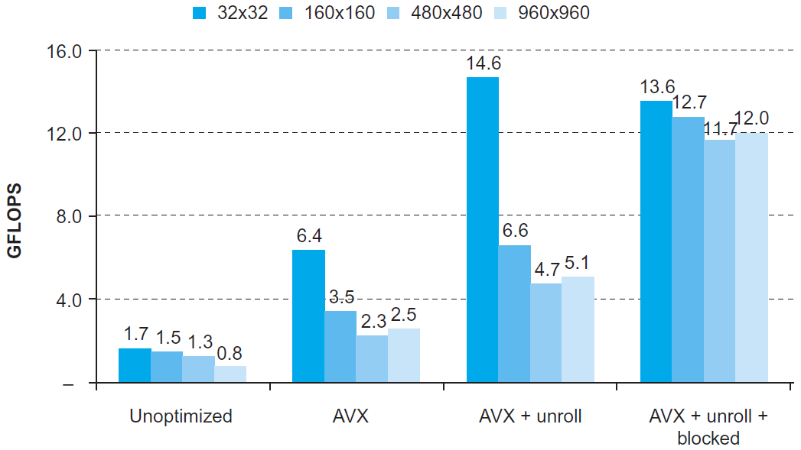
DGEMM
Combine cache blocking and subword parallelism

Slide 47
Pitfalls
Byte vs. word addressing
Example: 32-byte direct-mapped cache, 4-byte blocks
Byte 36 maps to block 1
Word 36 maps to block 4
Ignoring memory system effects when writing or generating code
Example: iterating over rows vs. columns of arrays
Large strides result in poor locality

Slide 48
Pitfalls
In multiprocessor with shared L2 or L3 cache
Less associativity than cores results in conflict misses
More cores ⇒ need to increase associativity
Using AMAT to evaluate performance of out-of-order processors
Ignores effect of non-blocked accesses
Instead, evaluate performance by simulation

Slide 49
Pitfalls
Extending address range using segments
E.g., Intel 80286
But a segment is not always big enough
Makes address arithmetic complicated
Implementing a VMM on an ISA not designed for virtualization
E.g., non-privileged instructions accessing hardware resources
Either extend ISA, or require guest OS not to use problematic instructions

Slide 50
Concluding Remarks
Fast memories are small, large memories are slow
We really want fast, large memories ☹
Caching gives this illusion ☺
Principle of locality
Programs use a small part of their memory space frequently
Memory hierarchy
L1 cache ↔ L2 cache ↔ … ↔ DRAM memory ↔ disk
Memory system design is critical for multiprocessors

