Slide 1
The Processor (2/3)
Microprocessor Design and Application
마이크로 프로세서 설계 및 응용
2017 Spring
Minseong Kim (김민성)
Chapter 4 (2/3)

Slide 2
Major topics
Chapter 1: Computer Abstractions and Technology
Chapter 2: Instructions: Language of the Computer
Chapter 3: Arithmetic for Computers
Chapter 4: The Processor
Chapter 5: Large and Fast: Exploiting Memory Hierarchy
Chapter 6: Parallel Processors from Client to Cloud

Slide 3
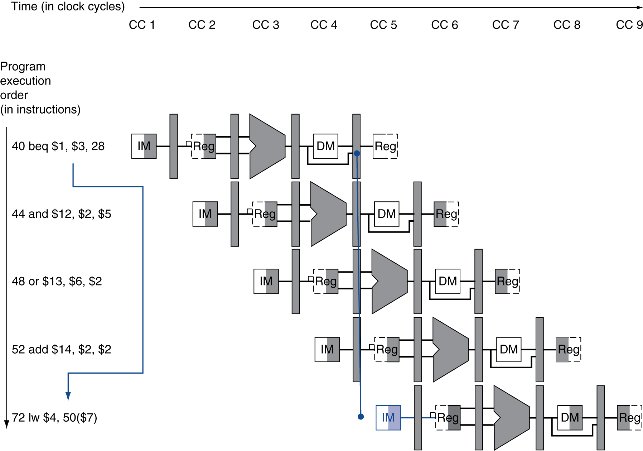
Branch Hazards
If branch outcome determined in MEM
Flush these instructions
(Set control values to 0)
PC

Slide 4
Reducing Branch Delay
Move hardware to determine outcome to ID stage
Target address adder
Register comparator
Example: branch taken
36: sub $10, $4, $8 40: beq $1, $3, 7 44: and $12, $2, $5 48: or $13, $2, $6 52: add $14, $4, $2 56: slt $15, $6, $7 ... 72: lw $4, 50($7)

Slide 5
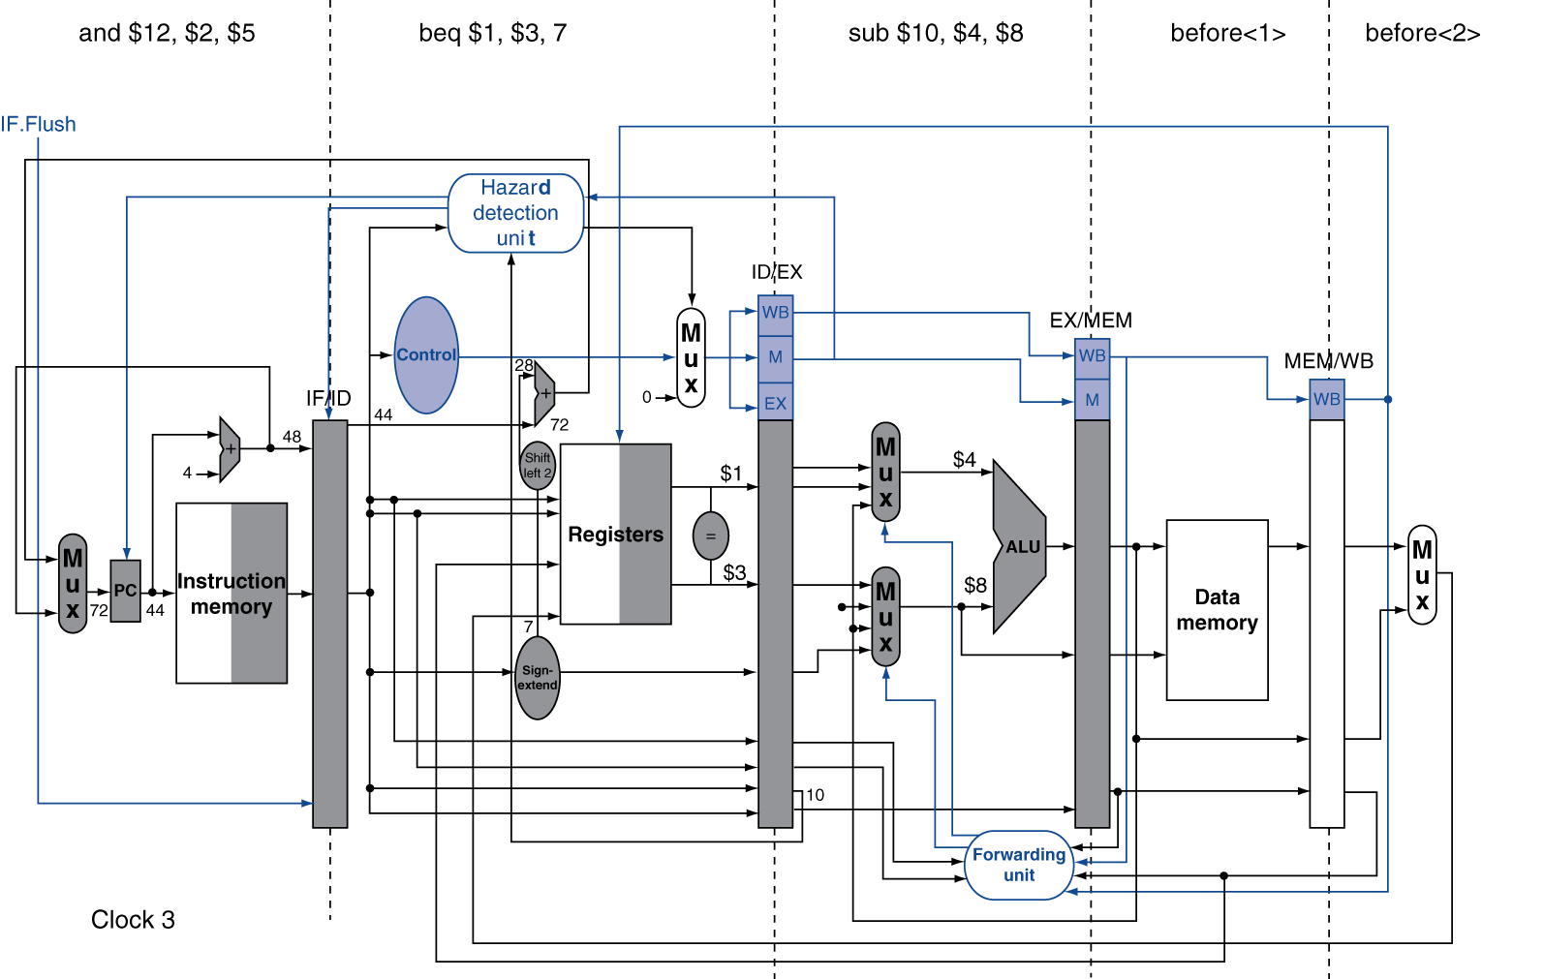
Example: Branch Taken

Slide 6
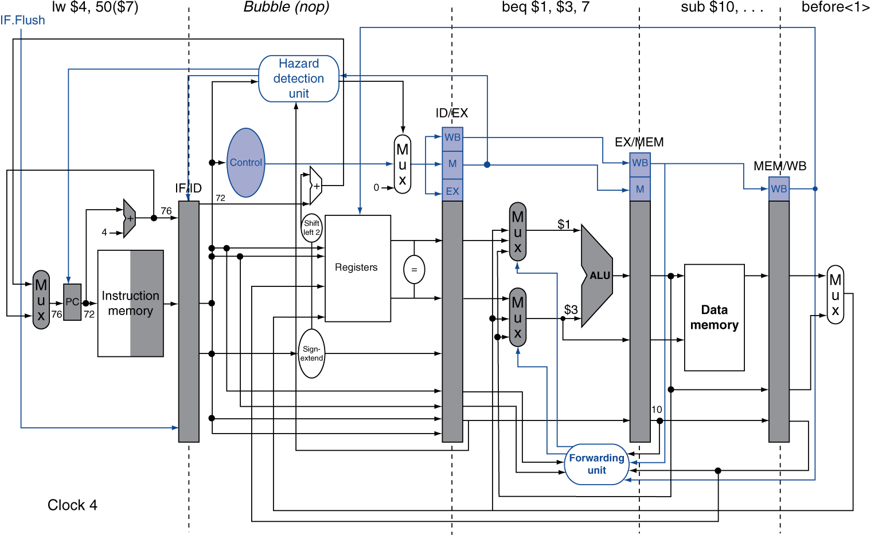
Example: Branch Taken

Slide 7
Data Hazards for Branches
If a comparison register is a destination of 2nd or 3rd preceding ALU instruction
Can resolve using forwarding
add $1, $2, $3
IF
ID
EX
MEM
WB
add $4, $5, $6
IF
ID
EX
MEM
WB
…
IF
ID
EX
MEM
WB
beq $1, $4, target
IF
ID
EX
MEM
WB

Slide 8
Data Hazards for Branches
If a comparison register is a destination of preceding ALU instruction or 2nd preceding load instruction
Need 1 stall cycle
lw $1, addr
IF
ID
EX
MEM
WB
add $4, $5, $6
IF
ID
EX
MEM
WB
beq stalled
IF
ID
beq $1, $4, target
ID
EX
MEM
WB

Slide 9
Data Hazards for Branches
If a comparison register is a destination of preceding ALU instruction or 2nd preceding load instruction
Need 1 stall cycle
lw $1, addr
IF
ID
EX
MEM
WB
add $4, $5, $6
IF
ID
EX
MEM
WB
beq stalled
IF
ID
beq $1, $4, target
ID
EX
MEM
WB

Slide 10
Data Hazards for Branches
If a comparison register is a destination of immediately preceding load instruction
Need 2 stall cycles
lw $1, addr
IF
ID
EX
MEM
WB
beq stalled
IF
ID
beq stalled
ID
beq $1, $0, target
ID
EX
MEM
WB

Slide 11
Dynamic Branch Prediction
In deeper and superscalar pipelines, branch penalty is more significant
Use dynamic prediction
Branch prediction buffer (aka branch history table)
Indexed by recent branch instruction addresses
Stores outcome (taken/not taken)
To execute a branch
Check table, expect the same outcome
Start fetching from fall-through or target
If wrong, flush pipeline and flip prediction

Slide 12
1-Bit Predictor: Shortcoming
Inner loop branches mispredicted twice!
Mispredict as taken on last iteration of inner loop
Then mispredict as not taken on first iteration of inner loop next time around
outer: … … inner: …
…
beq …, …, inner … beq …, …, outer

Slide 13
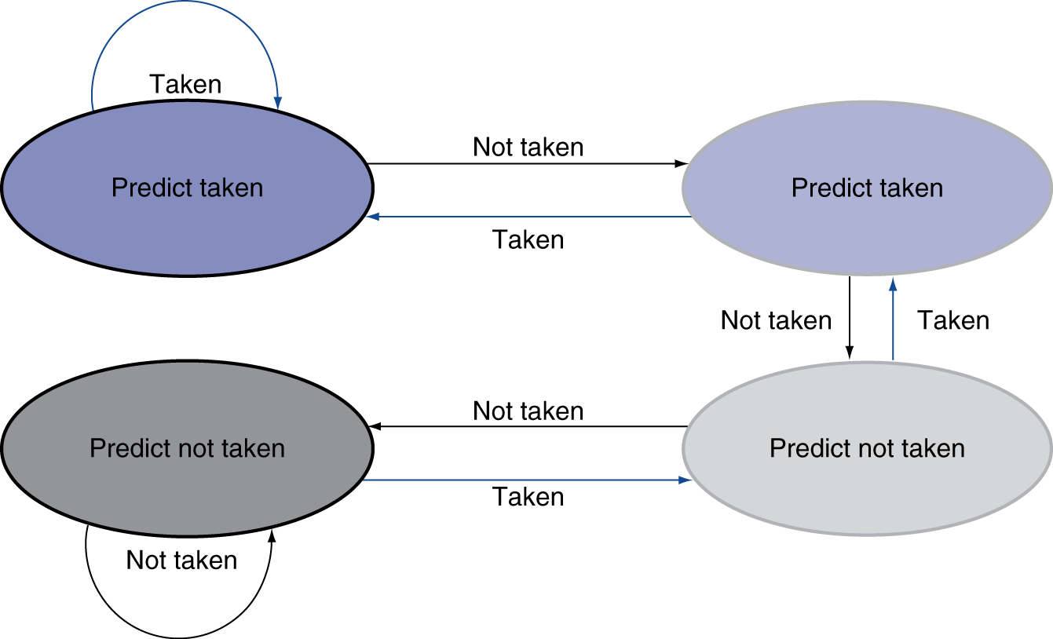
2-Bit Predictor
Only change prediction on two successive mispredictions

Slide 14
Calculating the Branch Target
Even with predictor, still need to calculate the target address
1-cycle penalty for a taken branch
Branch target buffer
Cache of target addresses
Indexed by PC when instruction fetched
If hit and instruction is branch predicted taken, can fetch target immediately

Slide 15
Exceptions and Interrupts
“Unexpected” events requiring change in flow of control
Different ISAs use the terms differently
Exception
Arises within the CPU
e.g., undefined opcode, overflow, syscall, …
Interrupt
From an external I/O controller
Dealing with them without sacrificing performance is hard

Slide 16
Handling Exceptions
In MIPS, exceptions managed by a System Control Coprocessor (CP0)
Save PC of offending (or interrupted) instruction
In MIPS: Exception Program Counter (EPC)
Save indication of the problem
In MIPS: Cause register
We’ll assume 1-bit
0 for undefined opcode, 1 for overflow
Jump to handler at 8000 00180

Slide 17
An Alternate Mechanism
Vectored Interrupts
Handler address determined by the cause
Example:
Undefined opcode: C000 0000
Overflow: C000 0020
…: C000 0040
Instructions either
Deal with the interrupt, or
Jump to real handler

Slide 18
Handler Actions
Read cause, and transfer to relevant handler
Determine action required
If restartable
Take corrective action
use EPC to return to program
Otherwise
Terminate program
Report error using EPC, cause, …

Slide 19
Exceptions in a Pipeline
Another form of control hazard
Consider overflow on add in EX stage
add $1, $2, $1
Prevent $1 from being clobbered
Complete previous instructions
Flush add and subsequent instructions
Set Cause and EPC register values
Transfer control to handler
Similar to mispredicted branch
Use much of the same hardware

Slide 20
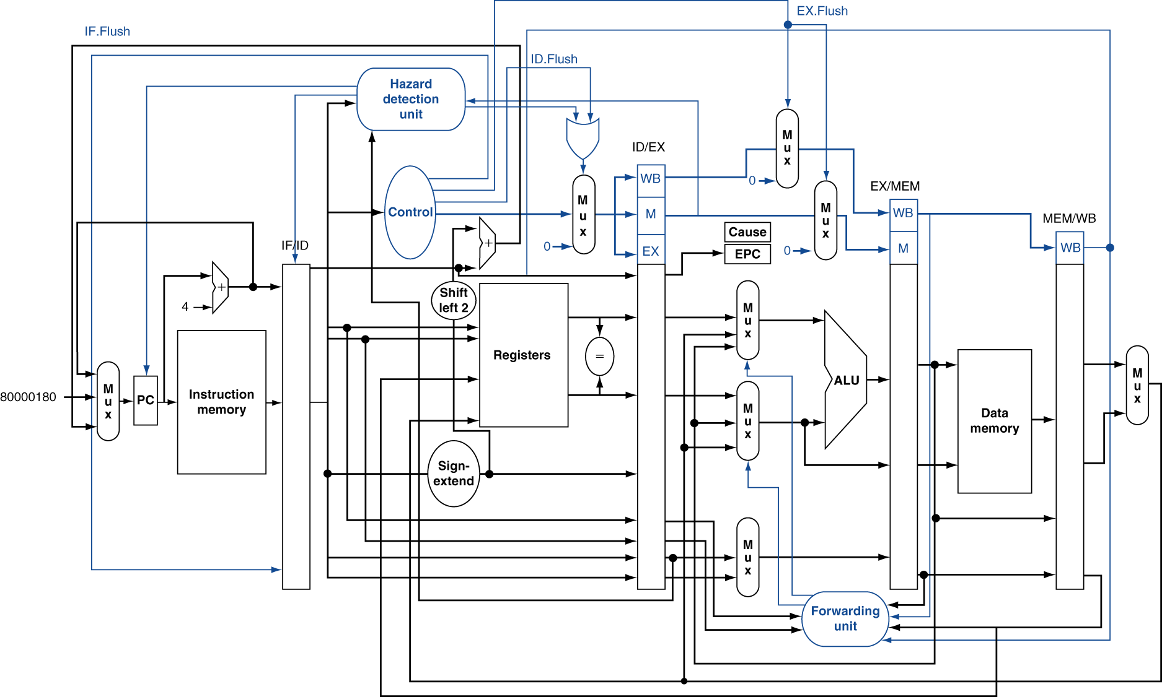
Pipeline with Exceptions

Slide 21
Exception Properties
Restartable exceptions
Pipeline can flush the instruction
Handler executes, then returns to the instruction
Refetched and executed from scratch
PC saved in EPC register
Identifies causing instruction
Actually PC + 4 is saved
Handler must adjust

Slide 22
Exception Example
Exception on add in
40 sub $11, $2, $4 44 and $12, $2, $5 48 or $13, $2, $6 4C add $1, $2, $1 50 slt $15, $6, $7 54 lw $16, 50($7) …
Handler
80000180 sw $25, 1000($0) 80000184 sw $26, 1004($0) …

Slide 23
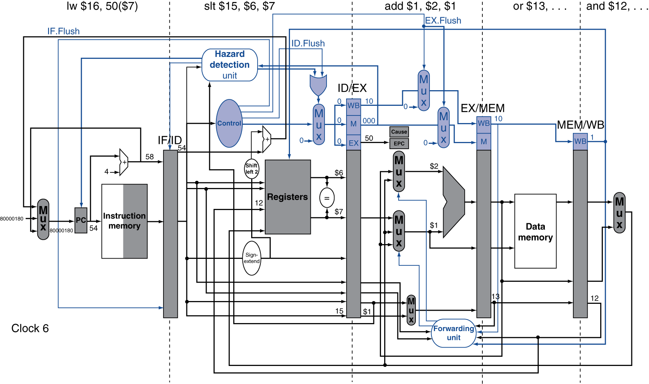
Exception Example

Slide 24
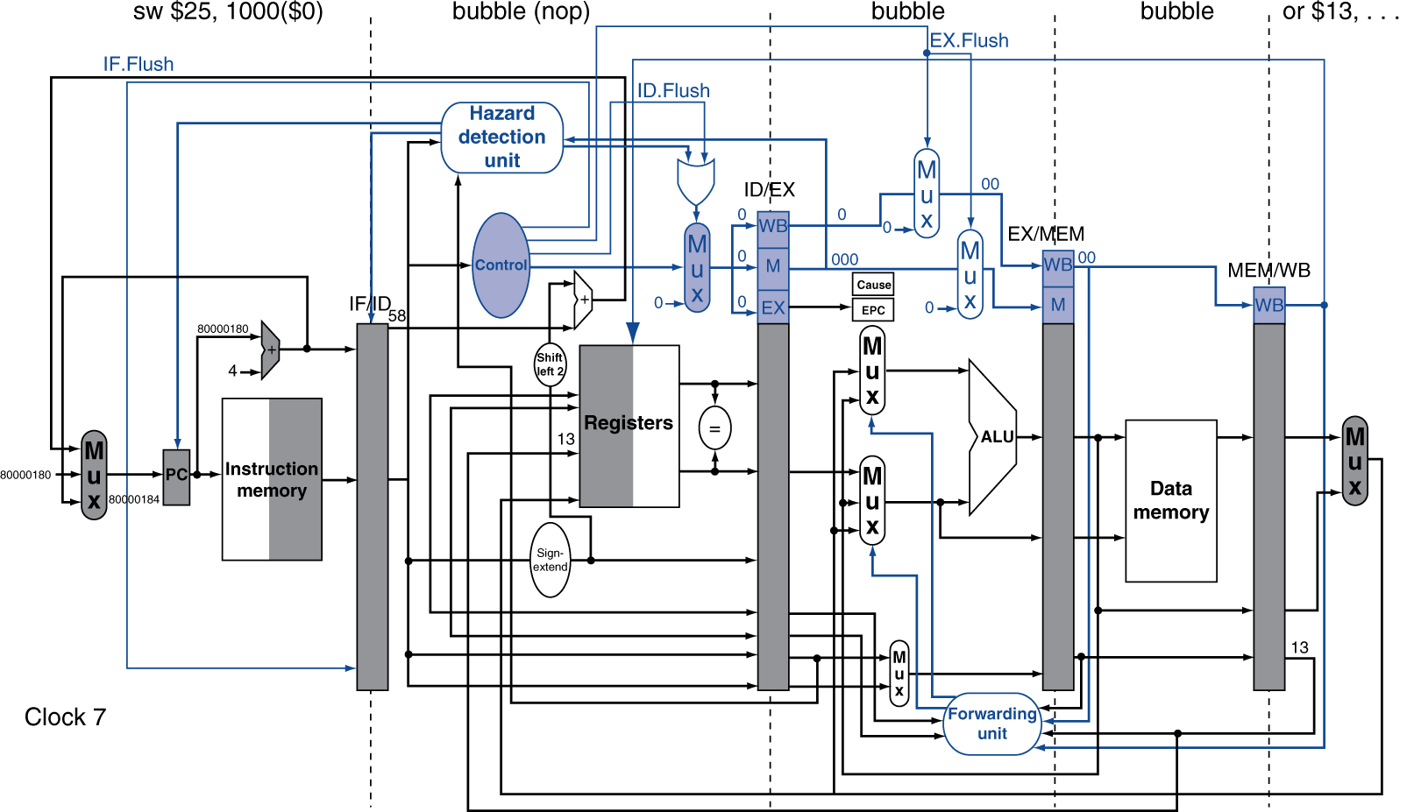
Exception Example

Slide 25
Multiple Exceptions
Pipelining overlaps multiple instructions
Could have multiple exceptions at once
Simple approach: deal with exception from earliest instruction
Flush subsequent instructions
“Precise” exceptions
In complex pipelines
Multiple instructions issued per cycle
Out-of-order completion
Maintaining precise exceptions is difficult!

Slide 26
Imprecise Exceptions
Just stop pipeline and save state
Including exception cause(s)
Let the handler work out
Which instruction(s) had exceptions
Which to complete or flush
May require “manual” completion
Simplifies hardware, but more complex handler software
Not feasible for complex multiple-issue out-of-order pipelines

Slide 27
Instruction-Level Parallelism (ILP)
Pipelining: executing multiple instructions in parallel
To increase ILP
Deeper pipeline
Less work per stage ⇒ shorter clock cycle
Multiple issue
Replicate pipeline stages ⇒ multiple pipelines
Start multiple instructions per clock cycle
CPI < 1, so use Instructions Per Cycle (IPC)
E.g., 4GHz 4-way multiple-issue
16 BIPS, peak CPI = 0.25, peak IPC = 4
But dependencies reduce this in practice

Slide 28
Multiple Issue
Static multiple issue
Compiler groups instructions to be issued together
Packages them into “issue slots”
Compiler detects and avoids hazards
Dynamic multiple issue
CPU examines instruction stream and chooses instructions to issue each cycle
Compiler can help by reordering instructions
CPU resolves hazards using advanced techniques at runtime

Slide 29
Speculation
“Guess” what to do with an instruction
Start operation as soon as possible
Check whether guess was right
If so, complete the operation
If not, roll-back and do the right thing
Common to static and dynamic multiple issue
Examples
Speculate on branch outcome
Roll back if path taken is different
Speculate on load
Roll back if location is updated

Slide 30
Compiler/Hardware Speculation
Compiler can reorder instructions
e.g., move load before branch
Can include “fix-up” instructions to recover from incorrect guess
Hardware can look ahead for instructions to execute
Buffer results until it determines they are actually needed
Flush buffers on incorrect speculation

Slide 31
Speculation and Exceptions
What if exception occurs on a speculatively executed instruction?
e.g., speculative load before null-pointer check
Static speculation
Can add ISA support for deferring exceptions
Dynamic speculation
Can buffer exceptions until instruction completion (which may not occur)

Slide 32
Static Multiple Issue
Compiler groups instructions into “issue packets”
Group of instructions that can be issued on a single cycle
Determined by pipeline resources required
Think of an issue packet as a very long instruction
Specifies multiple concurrent operations
⇒ Very Long Instruction Word (VLIW)

Slide 33
Scheduling Static Multiple Issue
Compiler must remove some/all hazards
Reorder instructions into issue packets
No dependencies with a packet
Possibly some dependencies between packets
Varies between ISAs; compiler must know!
Pad with nop if necessary

Slide 34
MIPS with Static Dual Issue
Two-issue packets
One ALU/branch instruction
One load/store instruction
64-bit aligned
ALU/branch, then load/store
Pad an unused instruction with nop
Address | Instruction type | Pipeline Stages
n | ALU/branch | IF | ID | EX | MEM | WB
n + 4 | Load/store | IF | ID | EX | MEM | WB
n + 8 | ALU/branch |  | IF | ID | EX | MEM | WB
n + 12 | Load/store |  | IF | ID | EX | MEM | WB
n + 16 | ALU/branch |  |  | IF | ID | EX | MEM | WB
n + 20 | Load/store |  |  | IF | ID | EX | MEM | WB

Slide 35
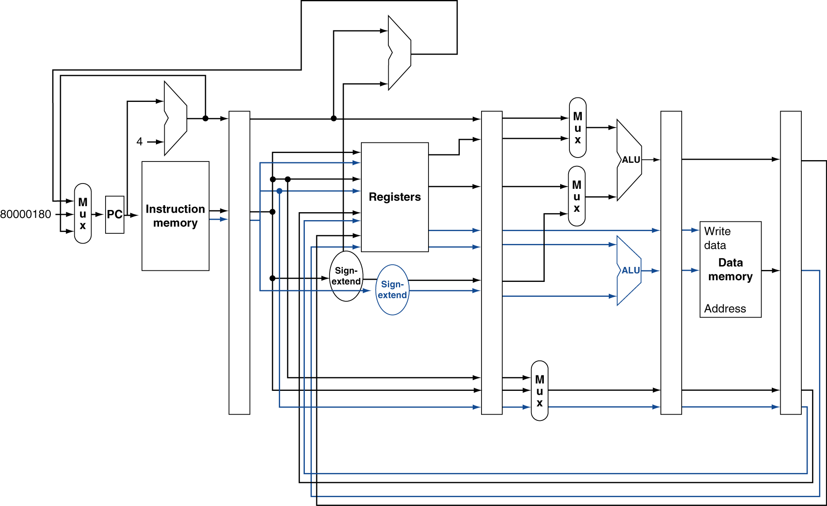
MIPS with Static Dual Issue

Slide 36
Hazards in the Dual-Issue MIPS
More instructions executing in parallel
EX data hazard
Forwarding avoided stalls with single-issue
Now can’t use ALU result in load/store in same packet
add $t0, $s0, $s1 load $s2, 0($t0)
Split into two packets, effectively a stall
Load-use hazard
Still one cycle use latency, but now two instructions
More aggressive scheduling required

Slide 37
Scheduling Example
Schedule this for dual-issue MIPS
IPC = 5/4 = 1.25 (c.f. peak IPC = 2)
Loop: lw $t0, 0($s1) # $t0=array element addu $t0, $t0, $s2 # add scalar in $s2 sw $t0, 0($s1) # store result addi $s1, $s1,–4 # decrement pointer bne $s1, $zero, Loop # branch $s1!=0
 | ALU/branch | Load/store | cycle
Loop: | nop | lw $t0, 0($s1) | 1
 | addi $s1, $s1,–4 | nop | 2
 | addu $t0, $t0, $s2 | nop | 3
 | bne $s1, $zero, Loop | sw $t0, 4($s1) | 4

Slide 38
Loop Unrolling
Replicate loop body to expose more parallelism
Reduces loop-control overhead
Use different registers per replication
Called “register renaming”
Avoid loop-carried “anti-dependencies”
Store followed by a load of the same register
Aka “name dependence”
Reuse of a register name

Slide 39
Loop Unrolling Example
IPC = 14/8 = 1.75
Closer to 2, but at cost of registers and code size
 | ALU/branch | Load/store | cycle
Loop: | addi $s1, $s1,–16 | lw $t0, 0($s1) | 1
 | nop | lw $t1, 12($s1) | 2
 | addu $t0, $t0, $s2 | lw $t2, 8($s1) | 3
 | addu $t1, $t1, $s2 | lw $t3, 4($s1) | 4
 | addu $t2, $t2, $s2 | sw $t0, 16($s1) | 5
 | addu $t3, $t4, $s2 | sw $t1, 12($s1) | 6
 | nop | sw $t2, 8($s1) | 7
 | bne $s1, $zero, Loop | sw $t3, 4($s1) | 8

Slide 40
Dynamic Multiple Issue
“Superscalar” processors
CPU decides whether to issue 0, 1, 2, … each cycle
Avoiding structural and data hazards
Avoids the need for compiler scheduling
Though it may still help
Code semantics ensured by the CPU

Slide 41
Dynamic Pipeline Scheduling
Allow the CPU to execute instructions out of order to avoid stalls
But commit result to registers in order
Example
lw $t0, 20($s2) addu $t1, $t0, $t2 sub $s4, $s4, $t3 slti $t5, $s4, 20
Can start sub while addu is waiting for lw

Slide 42
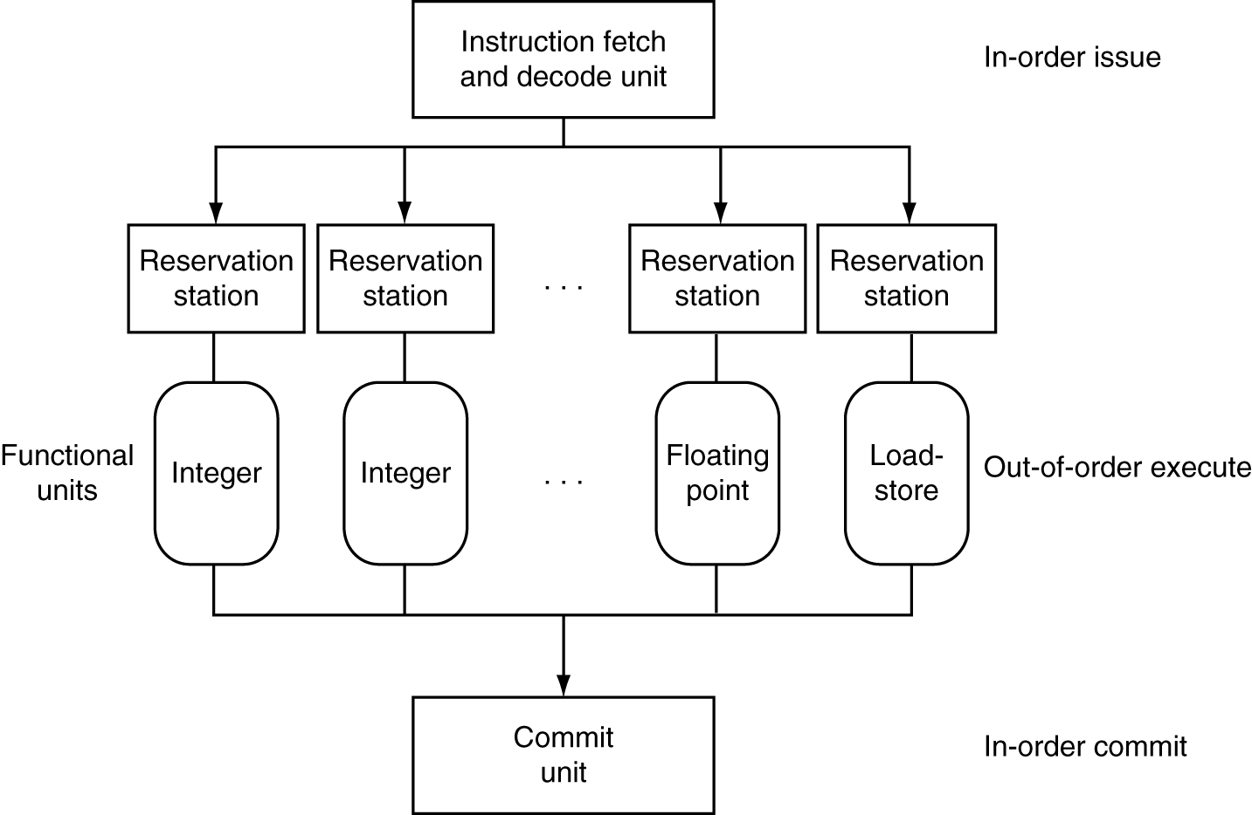
Dynamically Scheduled CPU
Preserves dependencies
Hold pending operands
Results also sent to any waiting reservation stations
Reorders buffer for register writes
Can supply operands for issued instructions

Slide 43
Register Renaming
Reservation stations and reorder buffer effectively provide register renaming
On instruction issue to reservation station
If operand is available in register file or reorder buffer
Copied to reservation station
No longer required in the register; can be overwritten
If operand is not yet available
It will be provided to the reservation station by a function unit
Register update may not be required

Slide 44
Speculation
Predict branch and continue issuing
Don’t commit until branch outcome determined
Load speculation
Avoid load and cache miss delay
Predict the effective address
Predict loaded value
Load before completing outstanding stores
Bypass stored values to load unit
Don’t commit load until speculation cleared

Slide 45
Why Do Dynamic Scheduling?
Why not just let the compiler schedule code?
Not all stalls are predicable
e.g., cache misses
Can’t always schedule around branches
Branch outcome is dynamically determined
Different implementations of an ISA have different latencies and hazards

Slide 46
Does Multiple Issue Work?
Yes, but not as much as we’d like
Programs have real dependencies that limit ILP
Some dependencies are hard to eliminate
e.g., pointer aliasing
Some parallelism is hard to expose
Limited window size during instruction issue
Memory delays and limited bandwidth
Hard to keep pipelines full
Speculation can help if done well

Slide 47
Power Efficiency
Complexity of dynamic scheduling and speculations requires power
Multiple simpler cores may be better
Microprocessor | Year | Clock Rate | Pipeline Stages | Issue width | Out-of-order/ Speculation | Cores | Power
i486 | 1989 | 25MHz | 5 | 1 | No | 1 | 5W
Pentium | 1993 | 66MHz | 5 | 2 | No | 1 | 10W
Pentium Pro | 1997 | 200MHz | 10 | 3 | Yes | 1 | 29W
P4 Willamette | 2001 | 2000MHz | 22 | 3 | Yes | 1 | 75W
P4 Prescott | 2004 | 3600MHz | 31 | 3 | Yes | 1 | 103W
Core | 2006 | 2930MHz | 14 | 4 | Yes | 2 | 75W
UltraSparc III | 2003 | 1950MHz | 14 | 4 | No | 1 | 90W
UltraSparc T1 | 2005 | 1200MHz | 6 | 1 | No | 8 | 70W

Slide 48
Cortex A8 and Intel i7
Processor | ARM A8 | Intel Core i7 920
Market | Personal Mobile Device | Server, cloud
Thermal design power | 2 Watts | 130 Watts
Clock rate | 1 GHz | 2.66 GHz
Cores/Chip | 1 | 4
Floating point? | No | Yes
Multiple issue? | Dynamic | Dynamic
Peak instructions/clock cycle | 2 | 4
Pipeline stages | 14 | 14
Pipeline schedule | Static in-order | Dynamic out-of-order with speculation
Branch prediction | 2-level | 2-level
1st level caches/core | 32 KiB I, 32 KiB D | 32 KiB I, 32 KiB D
2nd level caches/core | 128-1024 KiB | 256 KiB
3rd level caches (shared) | - | 2- 8 MB

Slide 49
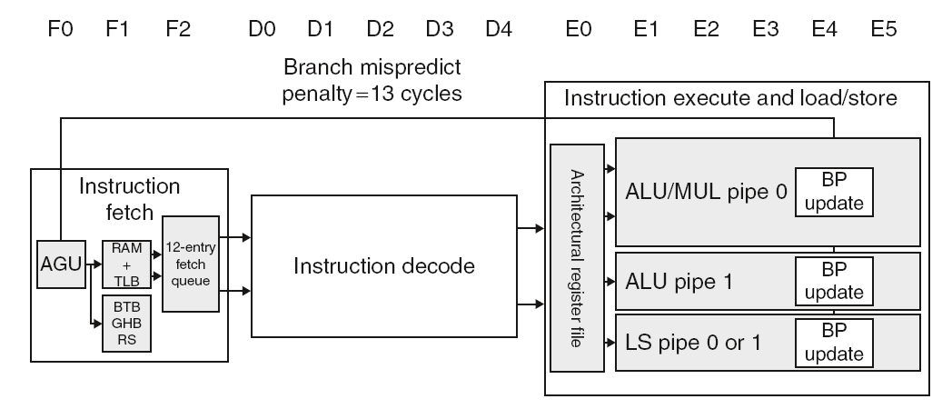
ARM Cortex-A8 Pipeline

Slide 50
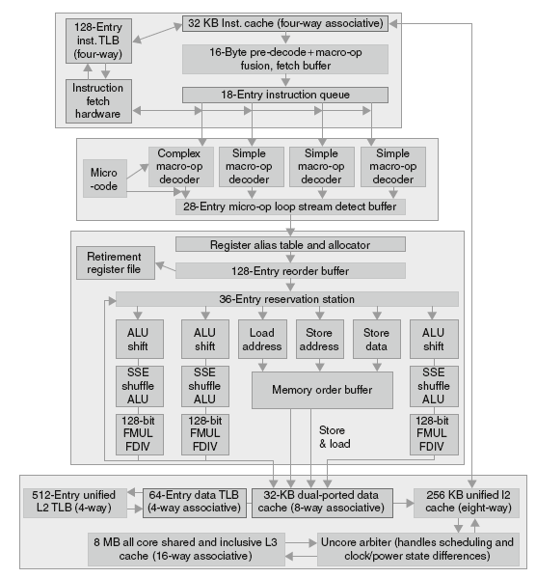
Core i7 Pipeline

Slide 51
Matrix Multiply
Unrolled C code
1 #include <x86intrin.h>
2 #define UNROLL (4)
3
4 void dgemm (int n, double* A, double* B, double* C)
5 {
6 for ( int i = 0; i < n; i+=UNROLL*4 )
7 for ( int j = 0; j < n; j++ ) {
8 __m256d c[4];
9 for ( int x = 0; x < UNROLL; x++ )
10 c[x] = _mm256_load_pd(C+i+x*4+j*n);
11
12 for( int k = 0; k < n; k++ )
13 {
14 __m256d b = _mm256_broadcast_sd(B+k+j*n);
15 for (int x = 0; x < UNROLL; x++)
16 c[x] = _mm256_add_pd(c[x],
17 _mm256_mul_pd(_mm256_load_pd(A+n*k+x*4+i), b));
18 }
19
20 for ( int x = 0; x < UNROLL; x++ )
21 _mm256_store_pd(C+i+x*4+j*n, c[x]);
22 }
23 }

Slide 52
Matrix Multiply
Assembly code:
1 vmovapd (%r11),%ymm4 # Load 4 elements of C into %ymm4
2 mov %rbx,%rax # register %rax = %rbx
3 xor %ecx,%ecx # register %ecx = 0
4 vmovapd 0x20(%r11),%ymm3 # Load 4 elements of C into %ymm3
5 vmovapd 0x40(%r11),%ymm2 # Load 4 elements of C into %ymm2
6 vmovapd 0x60(%r11),%ymm1 # Load 4 elements of C into %ymm1
7 vbroadcastsd (%rcx,%r9,1),%ymm0 # Make 4 copies of B element
8 add $0x8,%rcx # register %rcx = %rcx + 8
9 vmulpd (%rax),%ymm0,%ymm5 # Parallel mul %ymm1,4 A elements
10 vaddpd %ymm5,%ymm4,%ymm4 # Parallel add %ymm5, %ymm4
11 vmulpd 0x20(%rax),%ymm0,%ymm5 # Parallel mul %ymm1,4 A elements
12 vaddpd %ymm5,%ymm3,%ymm3 # Parallel add %ymm5, %ymm3
13 vmulpd 0x40(%rax),%ymm0,%ymm5 # Parallel mul %ymm1,4 A elements
14 vmulpd 0x60(%rax),%ymm0,%ymm0 # Parallel mul %ymm1,4 A elements
15 add %r8,%rax # register %rax = %rax + %r8
16 cmp %r10,%rcx # compare %r8 to %rax
17 vaddpd %ymm5,%ymm2,%ymm2 # Parallel add %ymm5, %ymm2
18 vaddpd %ymm0,%ymm1,%ymm1 # Parallel add %ymm0, %ymm1
19 jne 68 <dgemm+0x68> # jump if not %r8 != %rax
20 add $0x1,%esi # register % esi = % esi + 1
21 vmovapd %ymm4,(%r11) # Store %ymm4 into 4 C elements
22 vmovapd %ymm3,0x20(%r11) # Store %ymm3 into 4 C elements
23 vmovapd %ymm2,0x40(%r11) # Store %ymm2 into 4 C elements
24 vmovapd %ymm1,0x60(%r11) # Store %ymm1 into 4 C elements

Slide 53
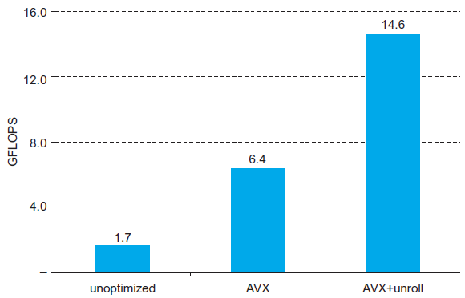
Performance Impact

Slide 54
Fallacies
Pipelining is easy (!)
The basic idea is easy
The devil is in the details
e.g., detecting data hazards
Pipelining is independent of technology
So why haven’t we always done pipelining?
More transistors make more advanced techniques feasible
Pipeline-related ISA design needs to take account of technology trends
e.g., predicated instructions

Slide 55
Pitfalls
Poor ISA design can make pipelining harder
e.g., complex instruction sets (VAX, IA-32)
Significant overhead to make pipelining work
IA-32 micro-op approach
e.g., complex addressing modes
Register update side effects, memory indirection
e.g., delayed branches
Advanced pipelines have long delay slots

Slide 56
Concluding Remarks
ISA influences design of datapath and control
Datapath and control influence design of ISA
Pipelining improves instruction throughput using parallelism
More instructions completed per second
Latency for each instruction not reduced
Hazards: structural, data, control
Multiple issue and dynamic scheduling (ILP)
Dependencies limit achievable parallelism
Complexity leads to the power wall

