Slide 1
The Processor (2/3)
Microprocessor Design and Application
마이크로 프로세서 설계 및 응용
2017 Spring
Minseong Kim (김민성)
Chapter 4 (2/3)

Slide 2
Major topics
Chapter 1: Computer Abstractions and Technology
Chapter 2: Instructions: Language of the Computer
Chapter 3: Arithmetic for Computers
Chapter 4: The Processor
Chapter 5: Large and Fast: Exploiting Memory Hierarchy
Chapter 6: Parallel Processors from Client to Cloud

Slide 3
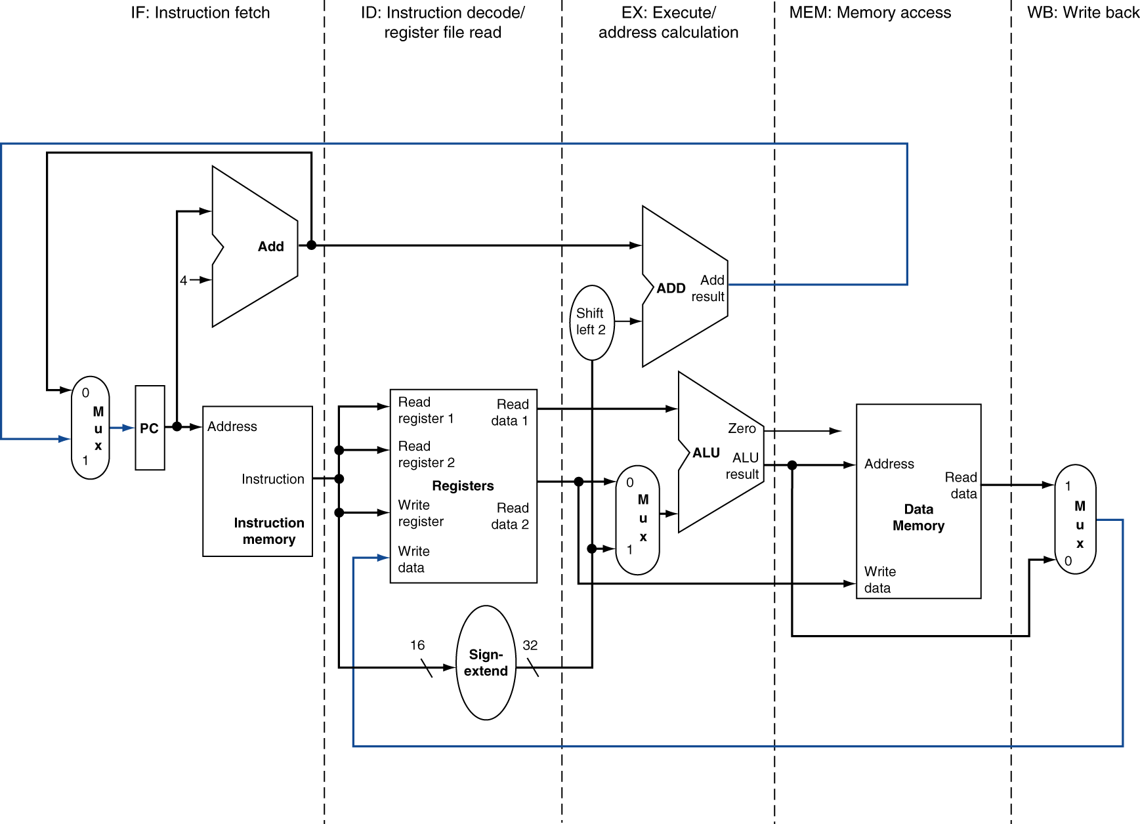
MIPS Pipelined Datapath
MEM
Right-to-left flow leads to hazards
WB

Slide 4
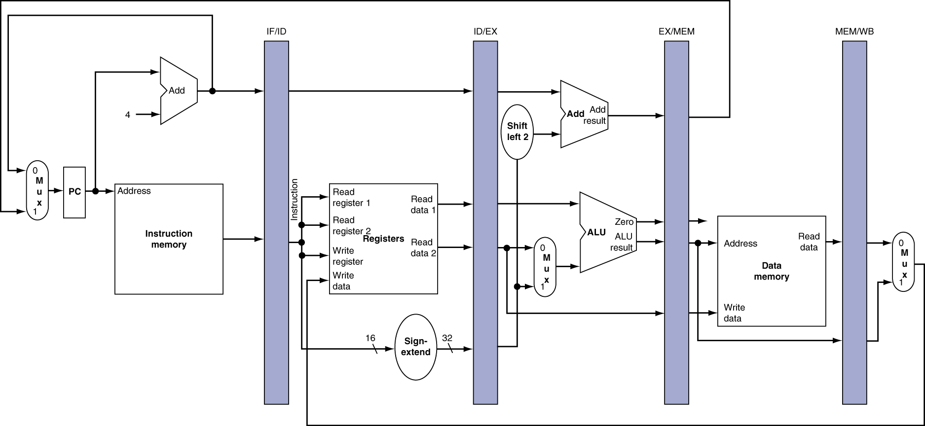
Pipeline registers
Need registers between stages
To hold information produced in previous cycle

Slide 5
Pipeline Operation
Cycle-by-cycle flow of instructions through the pipelined datapath
“Single-clock-cycle” pipeline diagram
Shows pipeline usage in a single cycle
Highlight resources used
c.f. “multi-clock-cycle” diagram
Graph of operation over time
We’ll look at “single-clock-cycle” diagrams for load & store

Slide 6
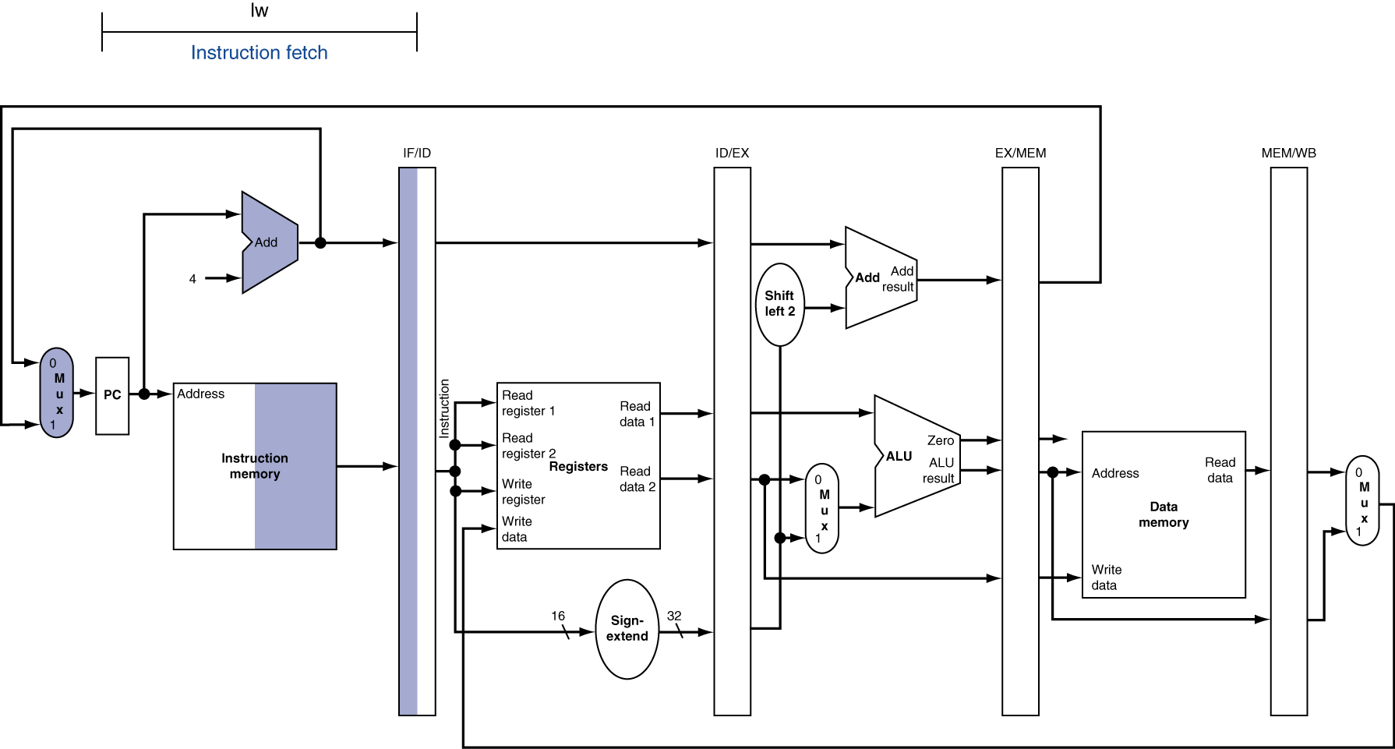
IF for Load, Store, …

Slide 7
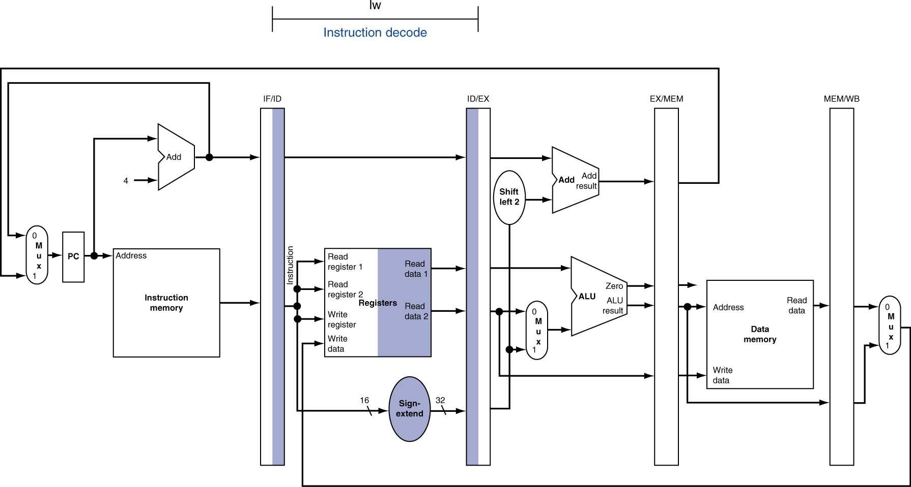
ID for Load, Store, …

Slide 8
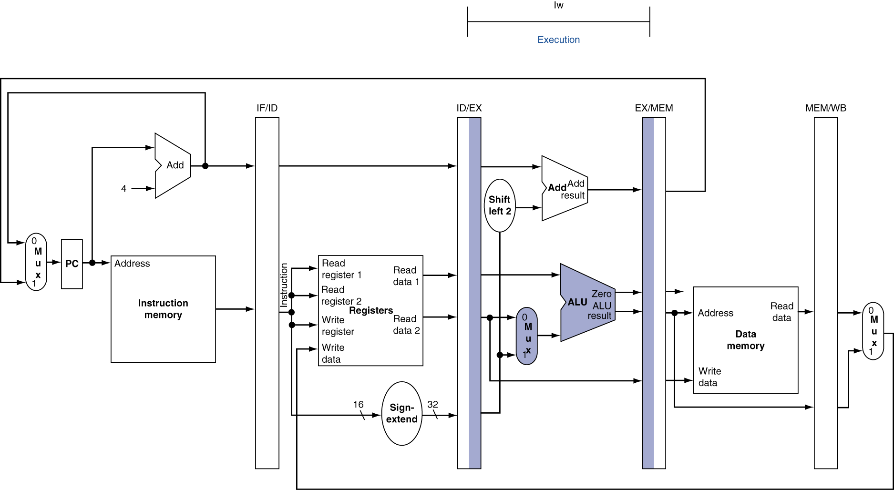
EX for Load

Slide 9
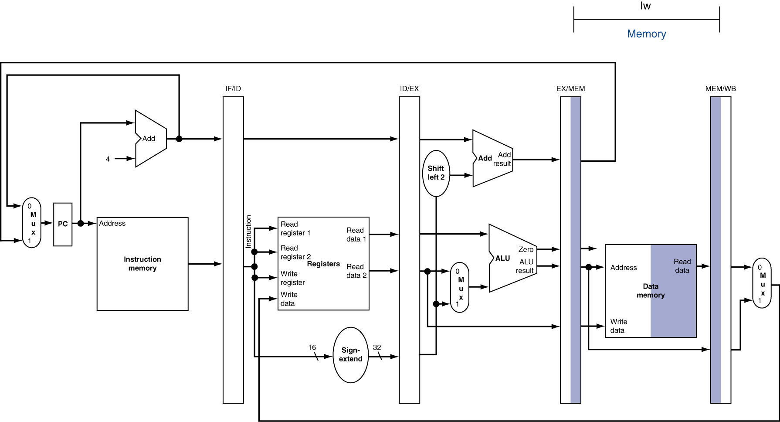
MEM for Load

Slide 10
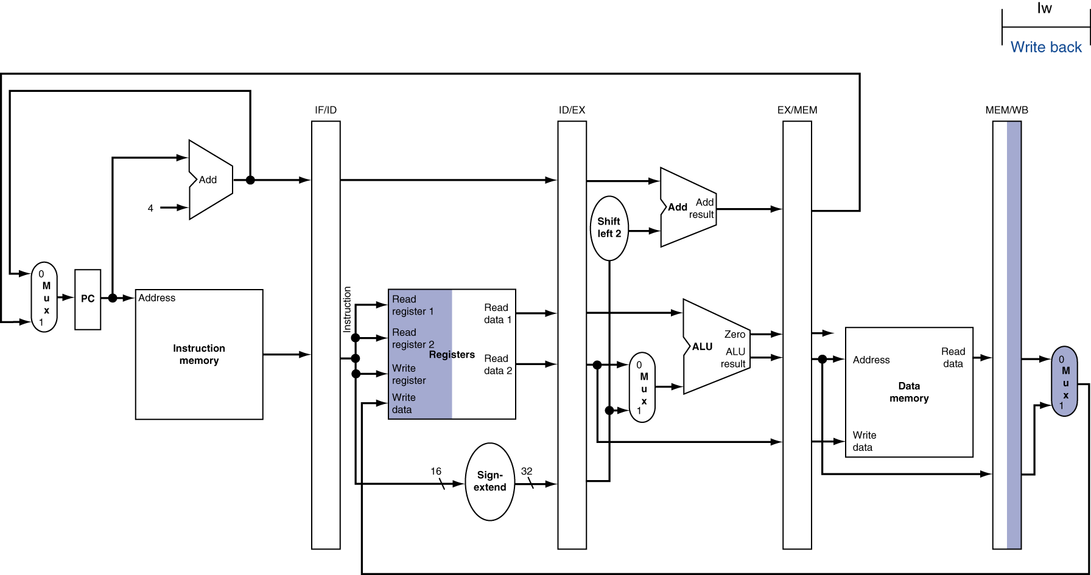
WB for Load

Slide 11
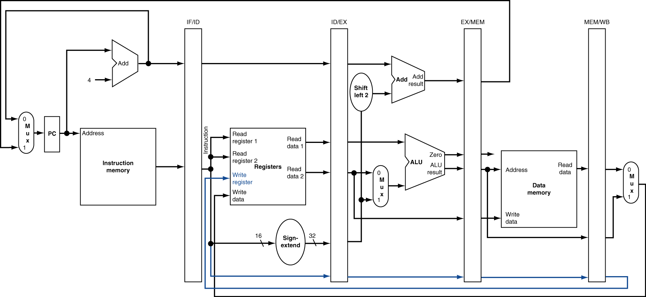
Corrected Datapath for Load

Slide 12
EX for Store

Slide 13
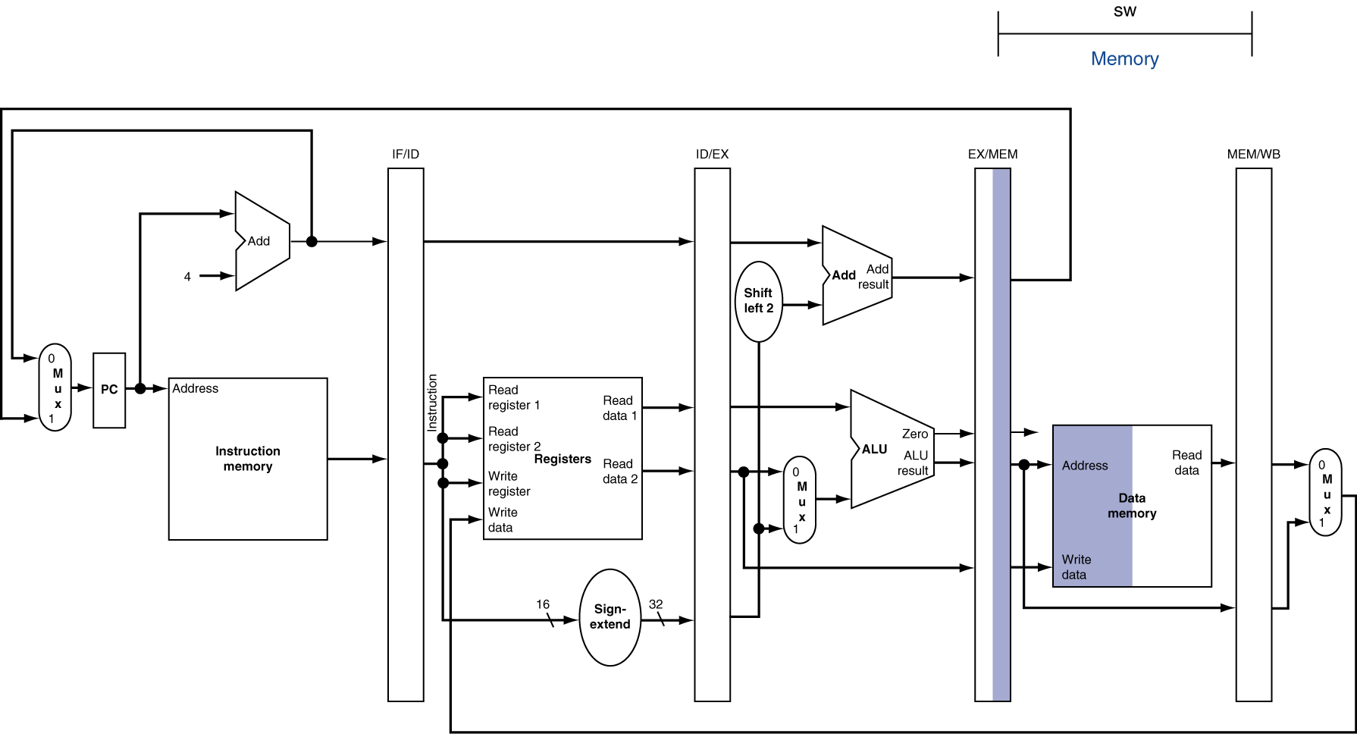
MEM for Store

Slide 14
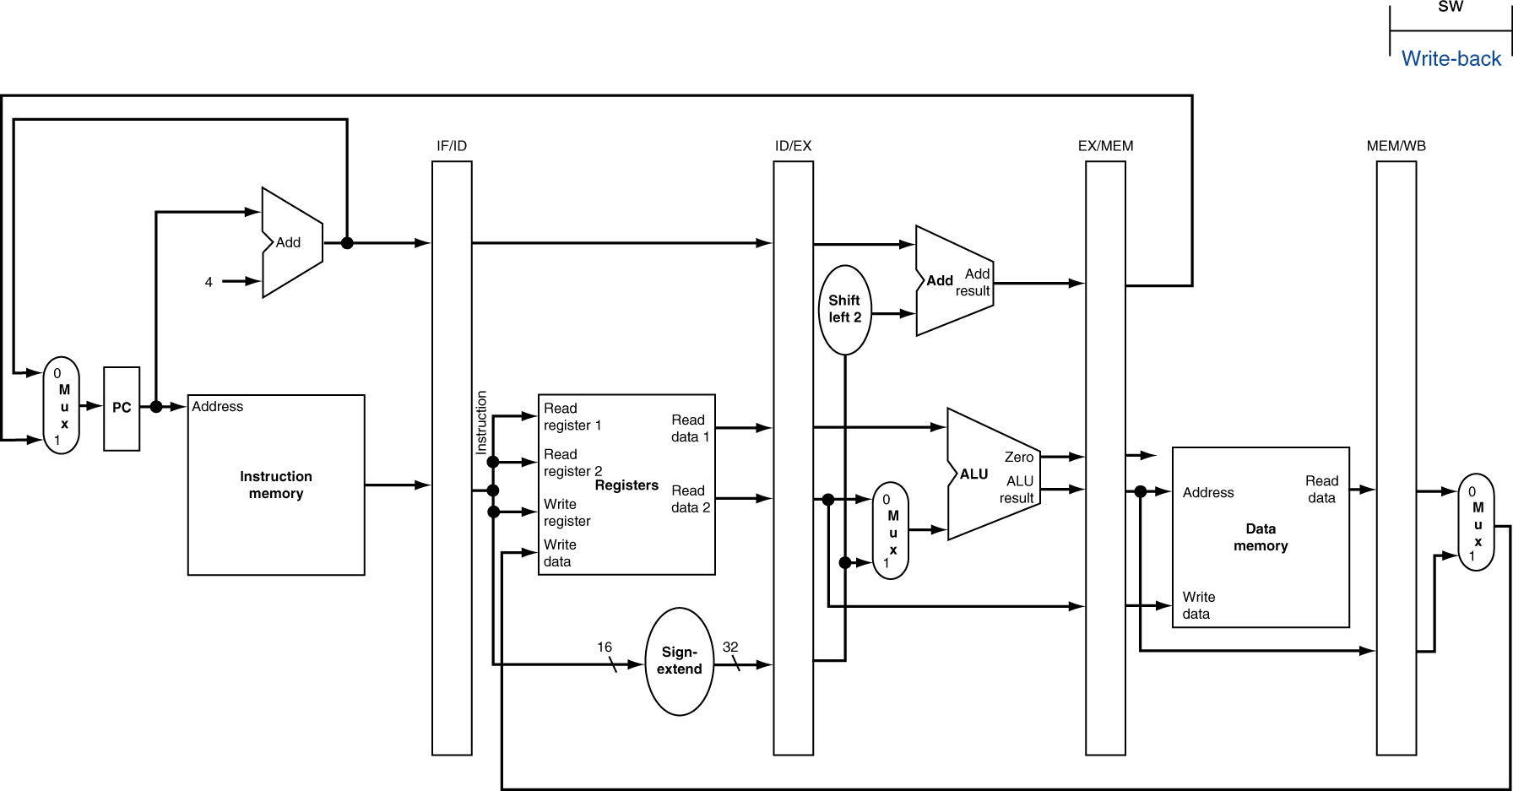
WB for Store

Slide 15
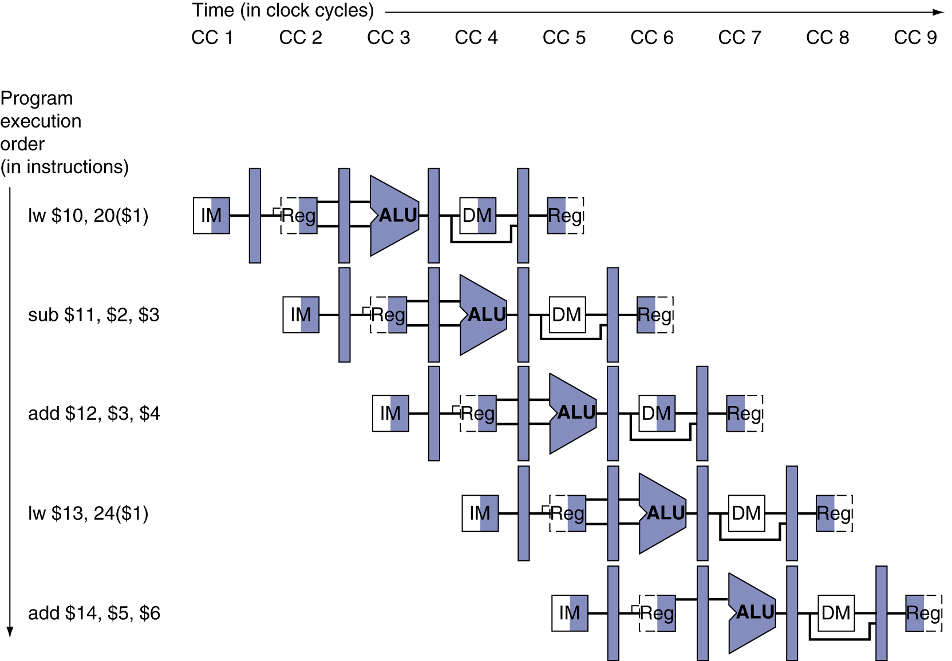
Multi-Cycle Pipeline Diagram
Form showing resource usage

Slide 16
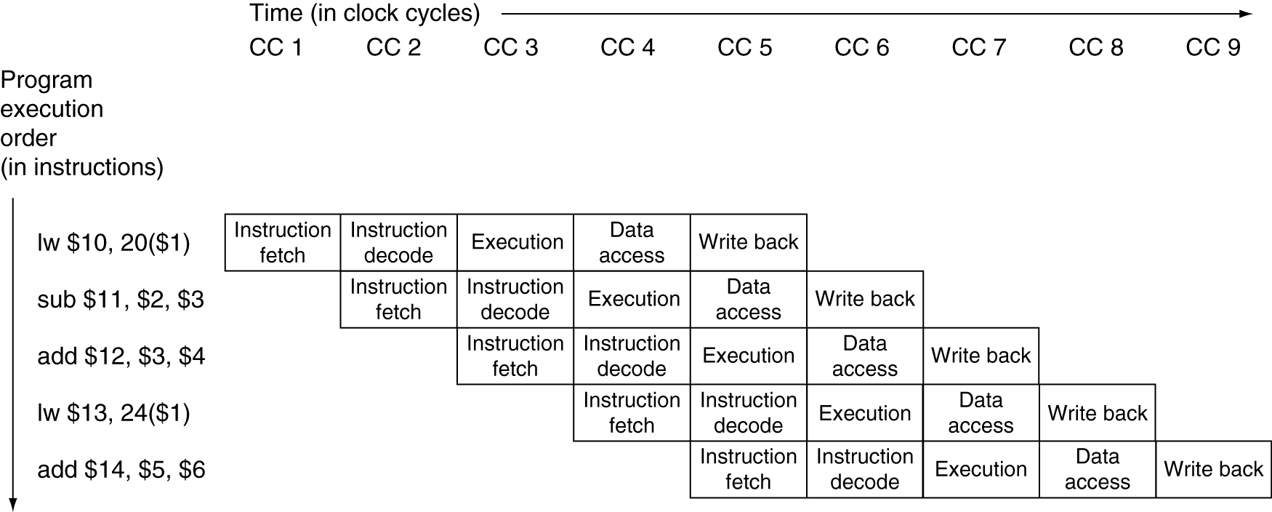
Multi-Cycle Pipeline Diagram
Traditional form

Slide 17
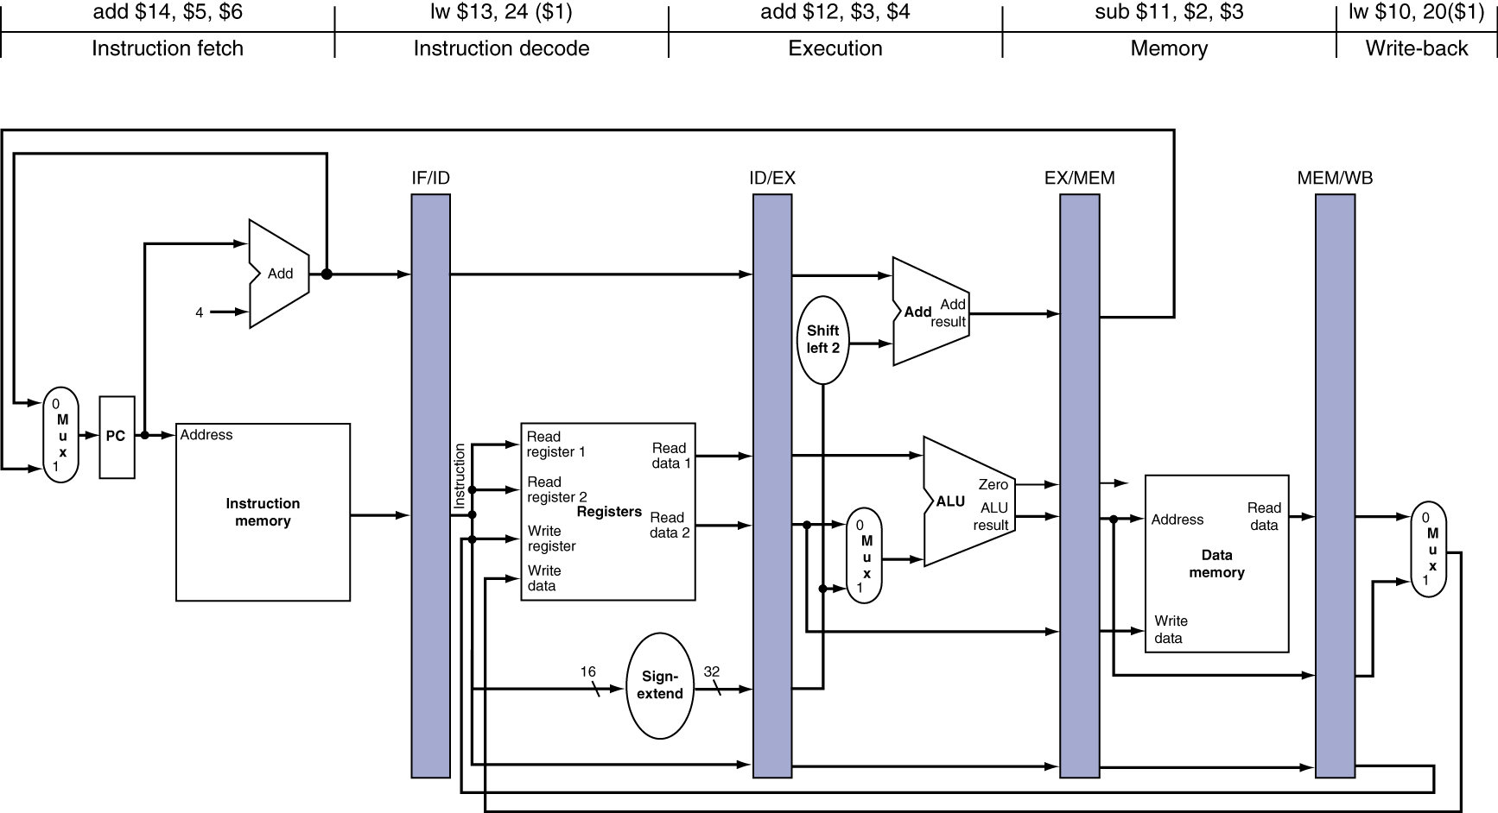
Single-Cycle Pipeline Diagram
State of pipeline in a given cycle

Slide 18
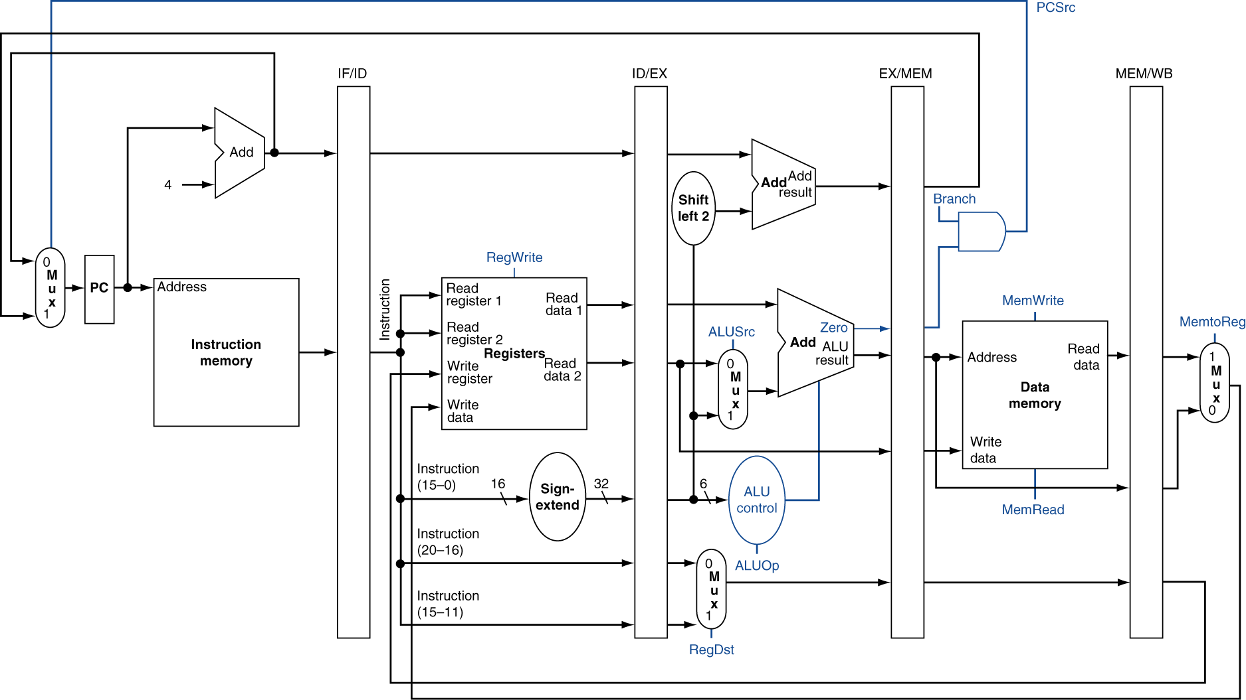
Pipelined Control (Simplified)

Slide 19
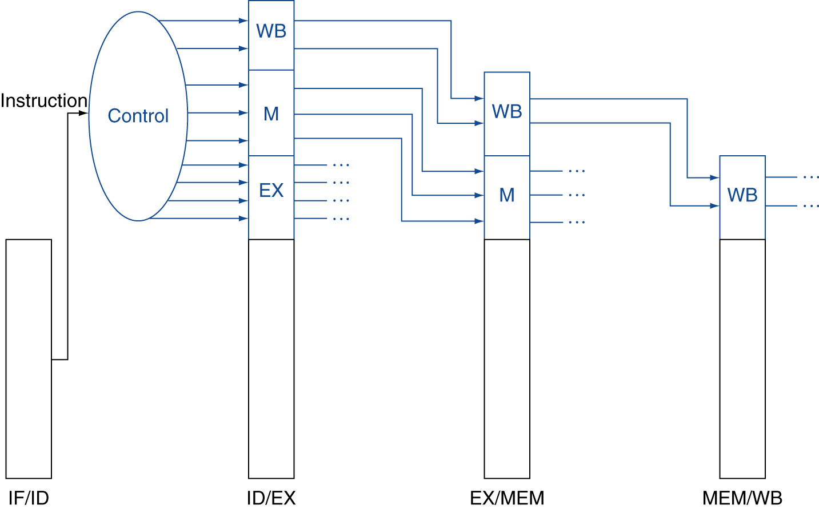
Pipelined Control
Control signals derived from instruction
As in single-cycle implementation

Slide 20
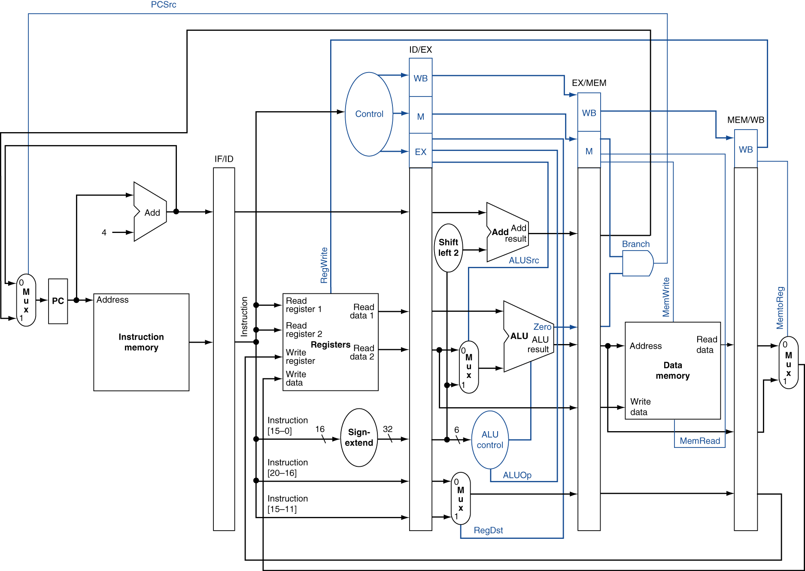
Pipelined Control

Slide 21
Data Hazards in ALU Instructions
Consider this sequence:
sub $2, $1,$3 and $12,$2,$5 or $13,$6,$2 add $14,$2,$2 sw $15,100($2)
We can resolve hazards with forwarding
How do we detect when to forward?

Slide 22
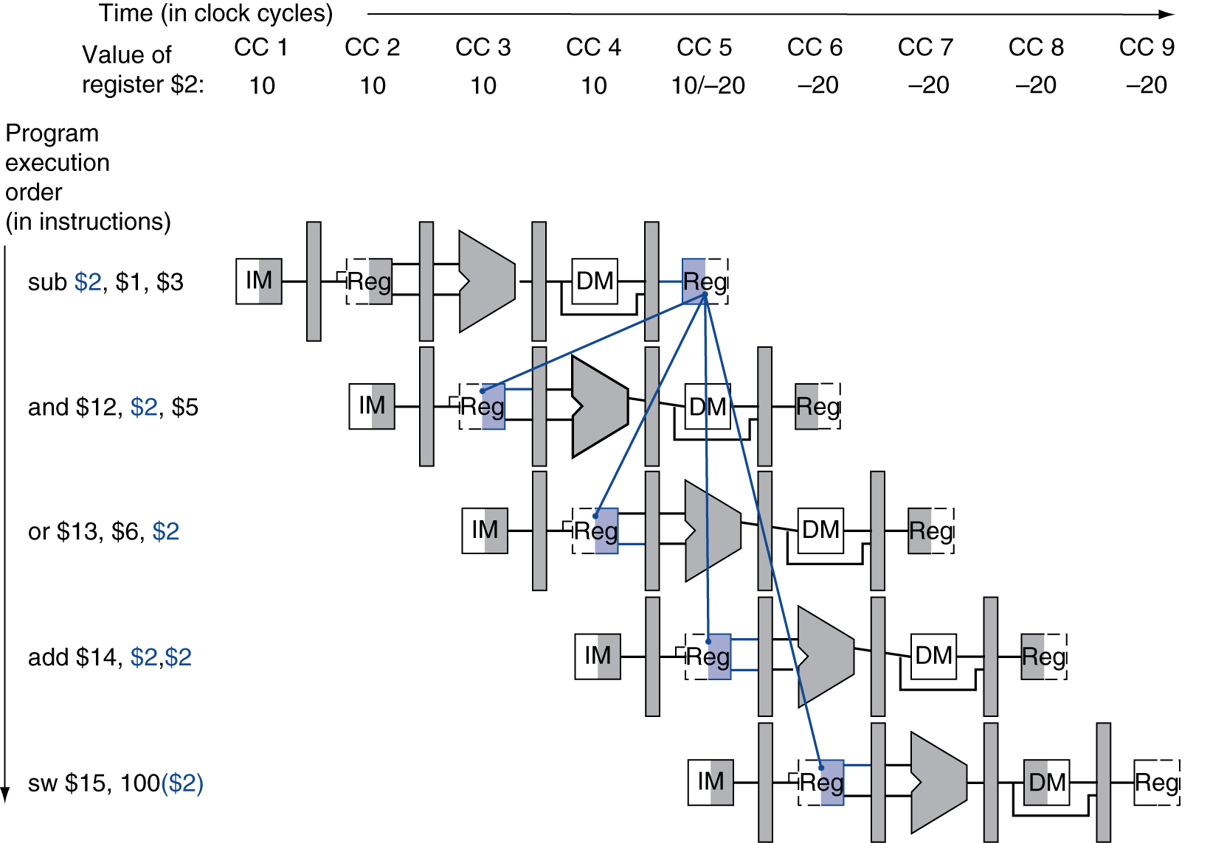
Dependencies & Forwarding

Slide 23
Dependencies & Forwarding

Slide 24
Detecting the Need to Forward
Pass register numbers along pipeline
e.g., ID/EX.RegisterRs = register number for Rs sitting in ID/EX pipeline register
ALU operand register numbers in EX stage are given by
ID/EX.RegisterRs, ID/EX.RegisterRt
Data hazards when
1a. EX/MEM.RegisterRd = ID/EX.RegisterRs
1b. EX/MEM.RegisterRd = ID/EX.RegisterRt
2a. MEM/WB.RegisterRd = ID/EX.RegisterRs
2b. MEM/WB.RegisterRd = ID/EX.RegisterRt

Slide 25
Detecting the Need to Forward
But only if forwarding instruction will write to a register!
EX/MEM.RegWrite, MEM/WB.RegWrite
And only if Rd for that instruction is not $zero
EX/MEM.RegisterRd ≠ 0, MEM/WB.RegisterRd ≠ 0

Slide 26
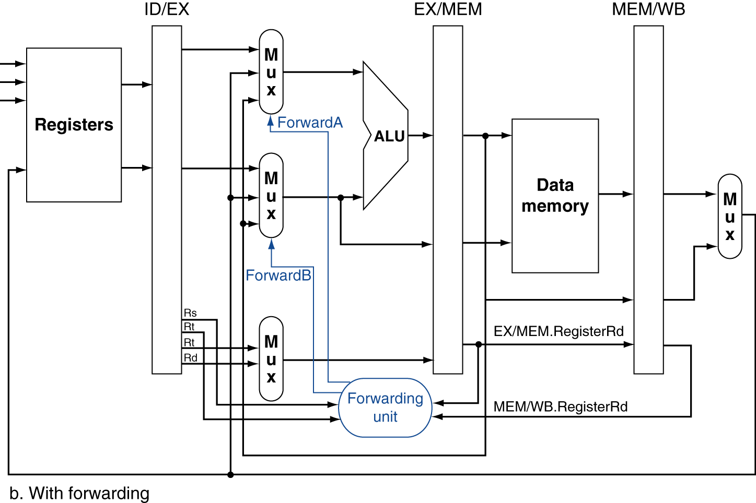
Forwarding Paths

Slide 27
Forwarding Conditions
EX hazard
if (EX/MEM.RegWrite and (EX/MEM.RegisterRd ≠ 0) and (EX/MEM.RegisterRd = ID/EX.RegisterRs)) ForwardA = 10
if (EX/MEM.RegWrite and (EX/MEM.RegisterRd ≠ 0) and (EX/MEM.RegisterRd = ID/EX.RegisterRt)) ForwardB = 10
MEM hazard
if (MEM/WB.RegWrite and (MEM/WB.RegisterRd ≠ 0) and (MEM/WB.RegisterRd = ID/EX.RegisterRs)) ForwardA = 01
if (MEM/WB.RegWrite and (MEM/WB.RegisterRd ≠ 0) and (MEM/WB.RegisterRd = ID/EX.RegisterRt)) ForwardB = 01

Slide 28
Double Data Hazard
Consider the sequence:
add $1,$1,$2 add $1,$1,$3 add $1,$1,$4
Both hazards occur
Want to use the most recent
Revise MEM hazard condition
Only fwd if EX hazard condition isn’t true

Slide 29
Revised Forwarding Condition
MEM hazard
if (MEM/WB.RegWrite and (MEM/WB.RegisterRd ≠ 0) and not (EX/MEM.RegWrite and (EX/MEM.RegisterRd ≠ 0) and (EX/MEM.RegisterRd = ID/EX.RegisterRs)) and (MEM/WB.RegisterRd = ID/EX.RegisterRs)) ForwardA = 01
if (MEM/WB.RegWrite and (MEM/WB.RegisterRd ≠ 0) and not (EX/MEM.RegWrite and (EX/MEM.RegisterRd ≠ 0) and (EX/MEM.RegisterRd = ID/EX.RegisterRt)) and (MEM/WB.RegisterRd = ID/EX.RegisterRt)) ForwardB = 01

Slide 30
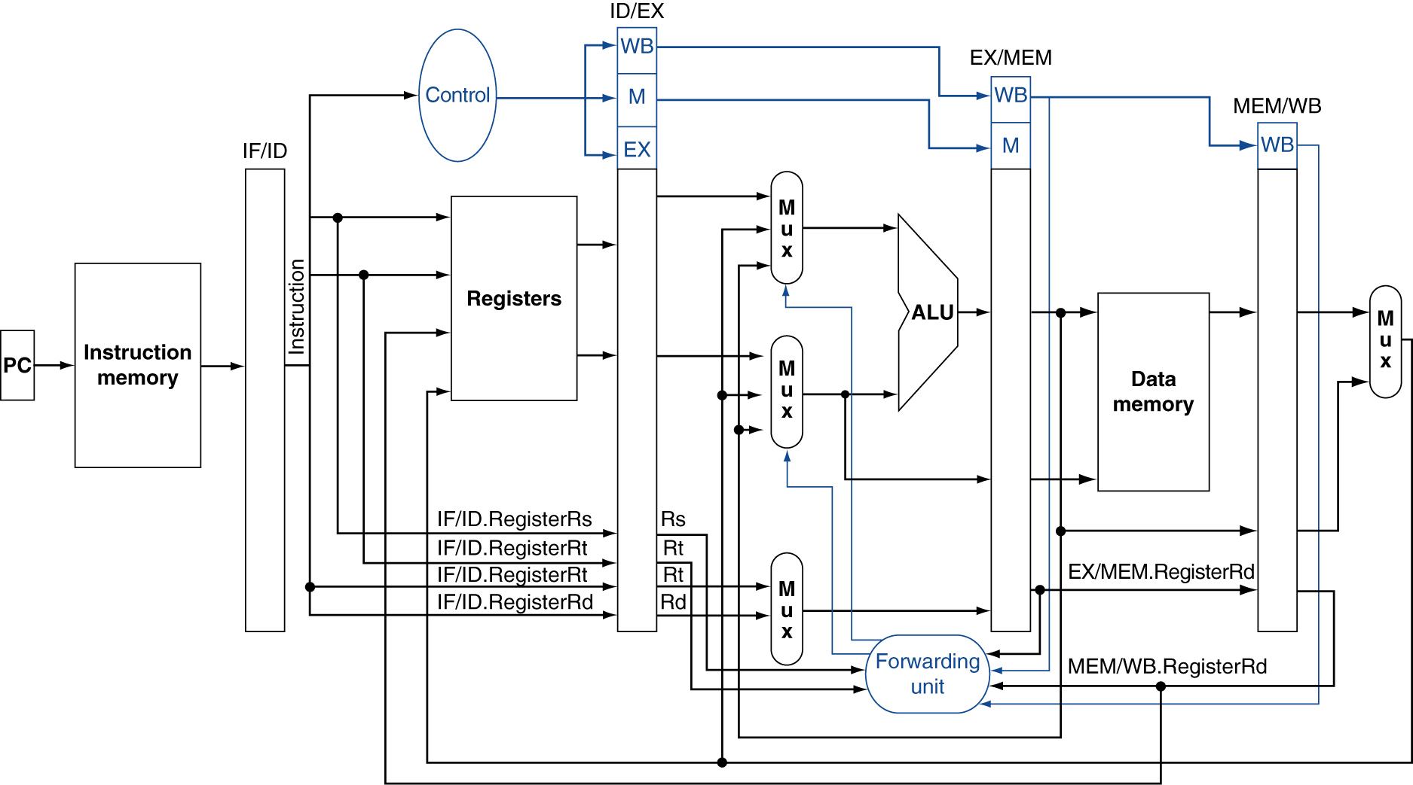
Datapath with Forwarding

Slide 31
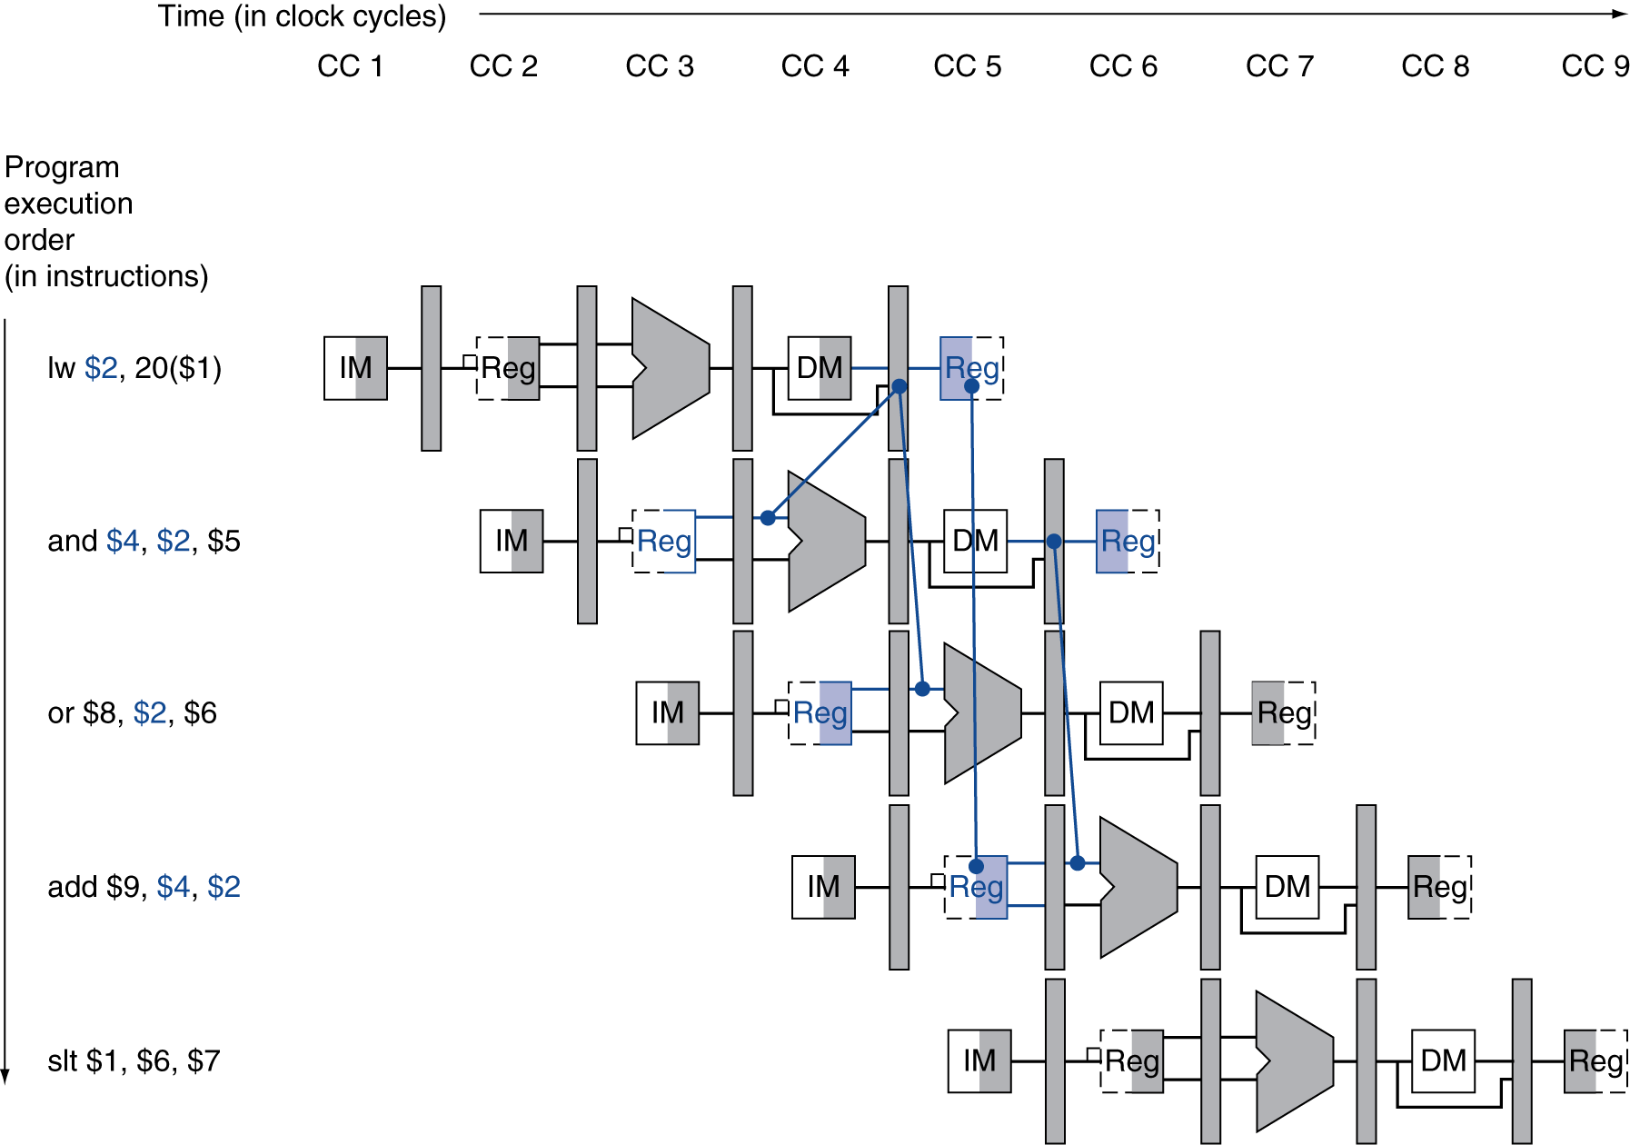
Load-Use Data Hazard

Slide 32
Load-Use Hazard Detection
Check when using instruction is decoded in ID stage
ALU operand register numbers in ID stage are given by
IF/ID.RegisterRs, IF/ID.RegisterRt
Load-use hazard when
ID/EX.MemRead and ((ID/EX.RegisterRt = IF/ID.RegisterRs) or (ID/EX.RegisterRt = IF/ID.RegisterRt))
If detected, stall and insert bubble

Slide 33
How to Stall the Pipeline
Force control values in ID/EX register to 0
EX, MEM and WB do nop (no-operation)
Prevent update of PC and IF/ID register
Using instruction is decoded again
Following instruction is fetched again
1-cycle stall allows MEM to read data for lw
Can subsequently forward to EX stage

Slide 34
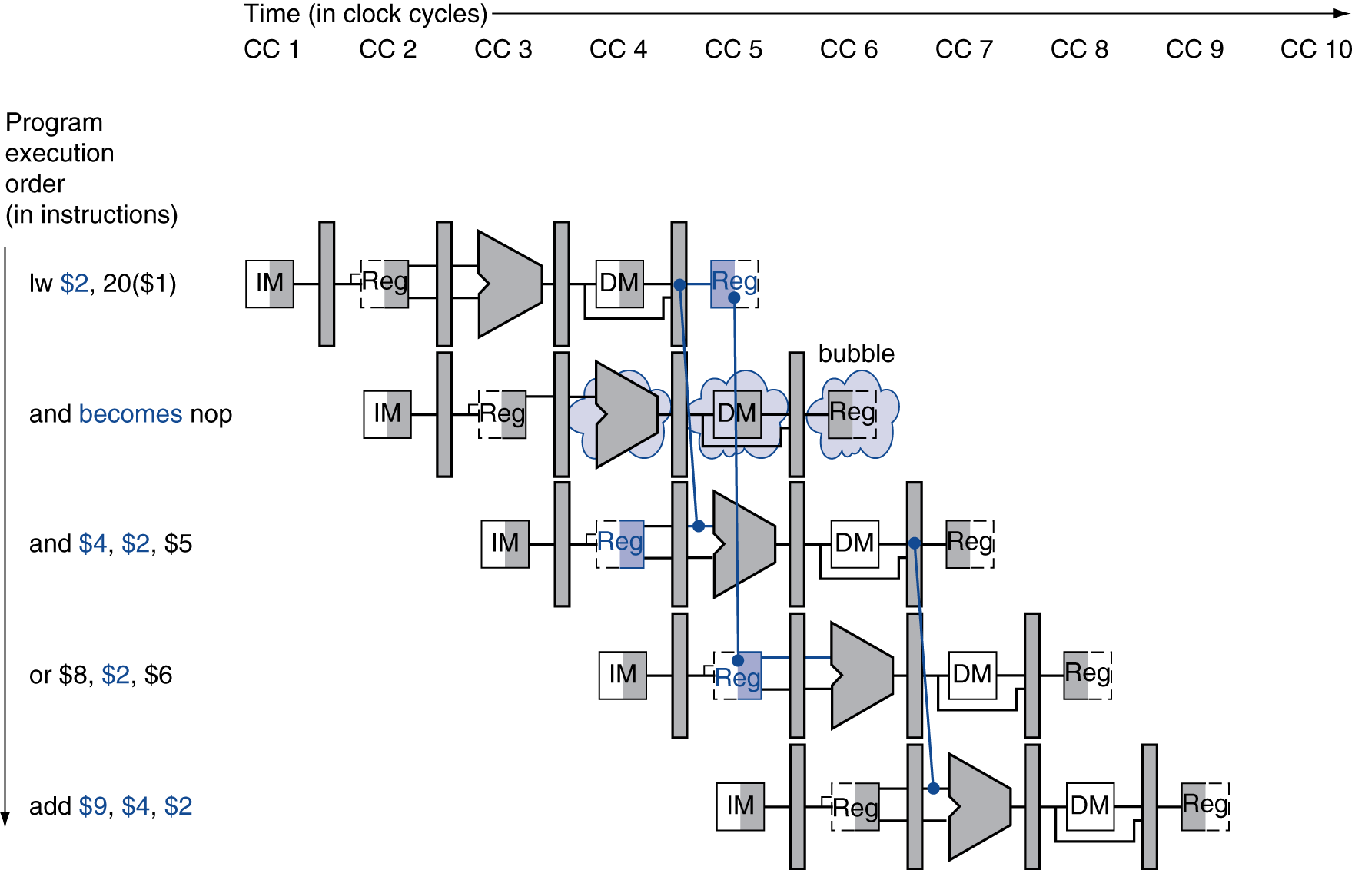
Stall/Bubble in the Pipeline
Stall inserted here

Slide 35
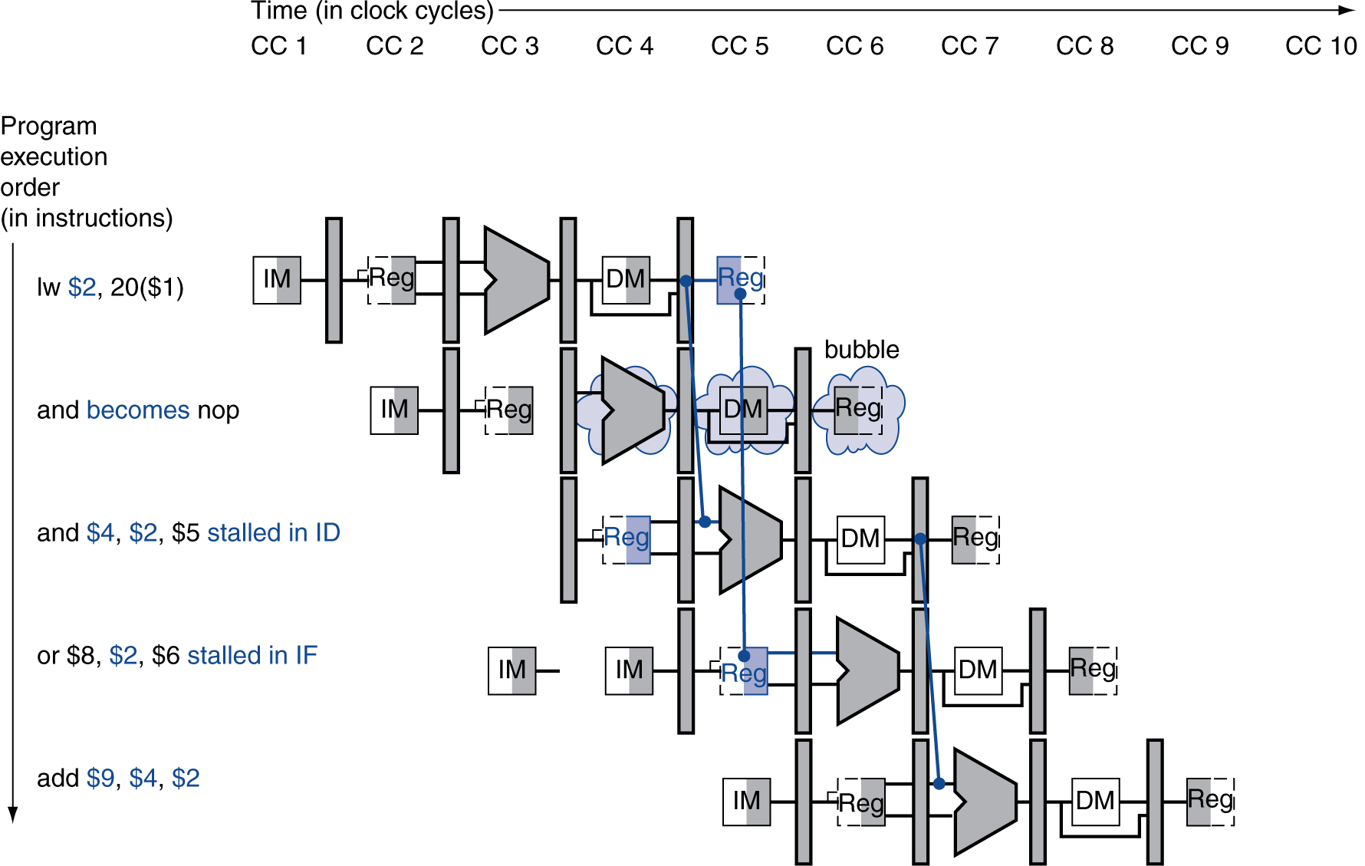
Stall/Bubble in the Pipeline
Or, more accurately…

Slide 36
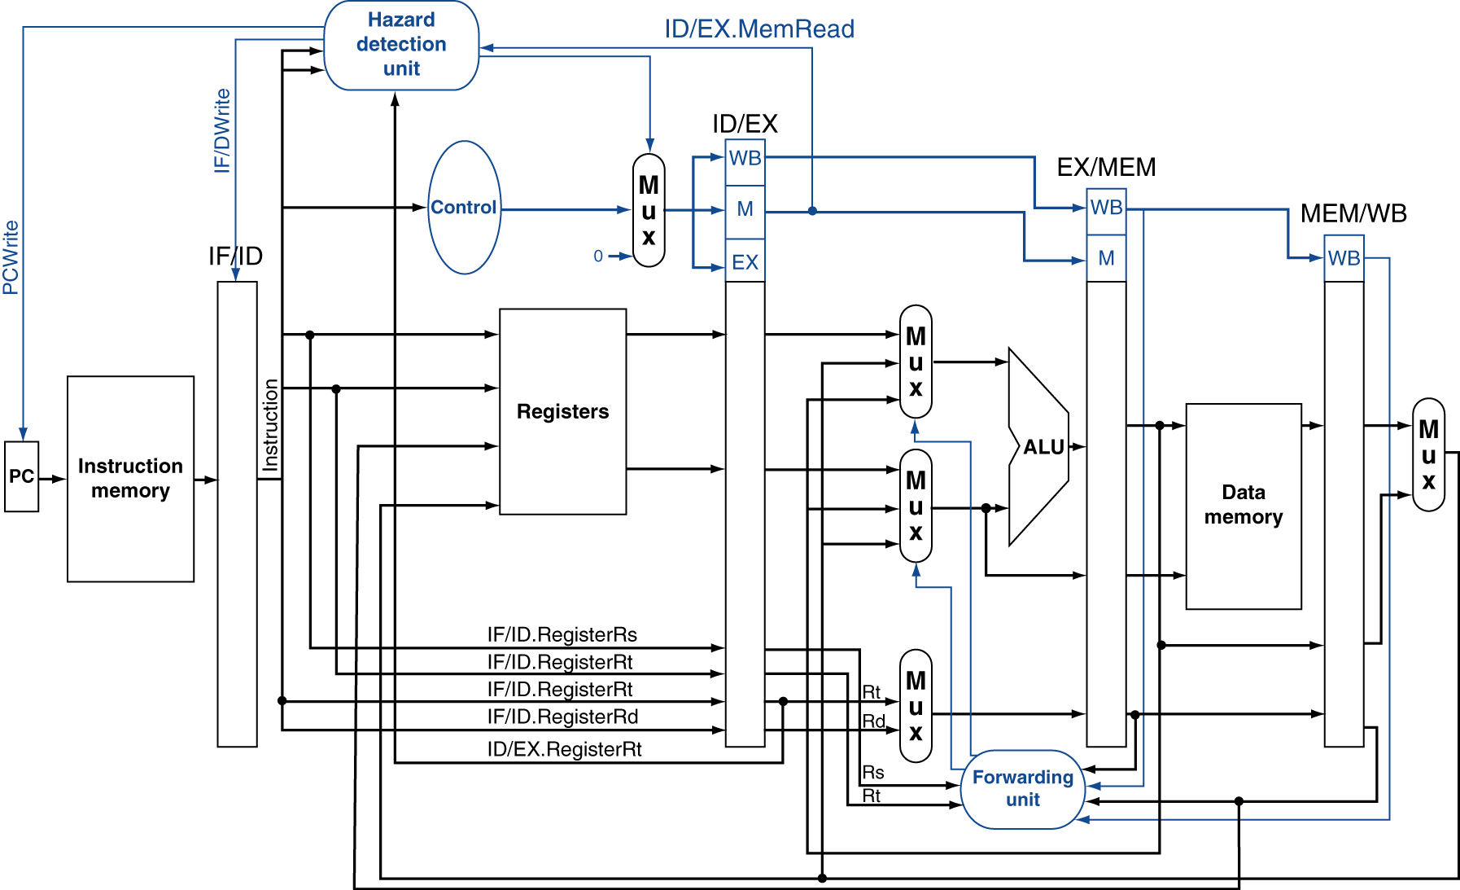
Datapath with Hazard Detection

Slide 37
Stalls and Performance
Stalls reduce performance
But are required to get correct results
Compiler can arrange code to avoid hazards and stalls
Requires knowledge of the pipeline structure

